Slide 1
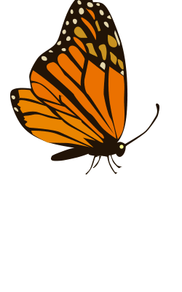
Monarch Butterfly
The Monarch Highway

Slide 2
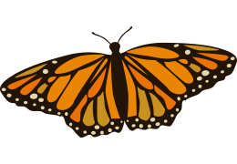
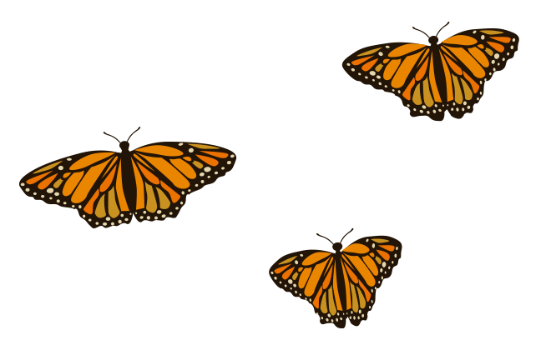
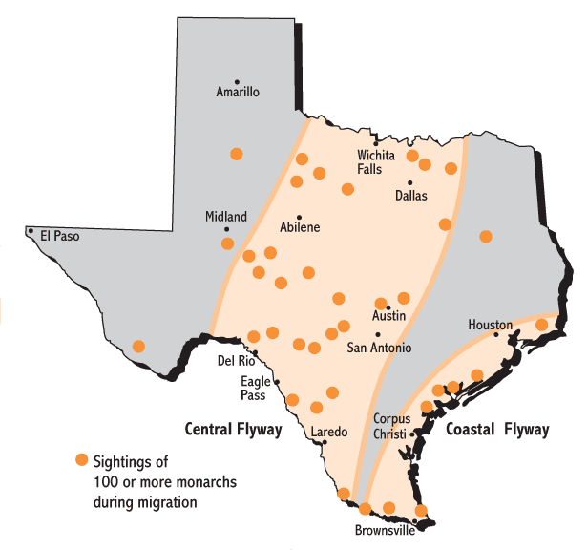
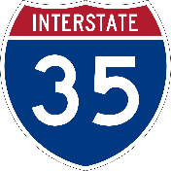
Did you Know?
The monarch butterfly migrates from Canada to Mexico every year to escape the cold and find food sources.
Biologists at TxDOT found that monarchs travel along the same paths as humans!.
TxDOT plants 3,500 acres of wildflowers each year to help protect pollinators.
Sightings of 100 or more monarchs during migration
Notes:
The monarch butterfly migrates from Canada to Mexico every year to escape the cold and find food sources. Scientists follow their paths because monarchs are important for biodiversity, pollination and because they are in danger of becoming extinct.
Biologists at TxDOT found that monarchs travel along the same paths as humans! During their migration, they fly near the Interstate 35 corridor, the major highway going from north to south Texas. TxDOT planted native flowering plants to create pollinator gardens at rest stops along I-35.
TxDOT plants 3,500 acres of wildflowers each year to help protect pollinators.

Slide 3
Fast Facts
Monarch butterflies can travel as far as 100 miles per day during migration season.

Slide 4
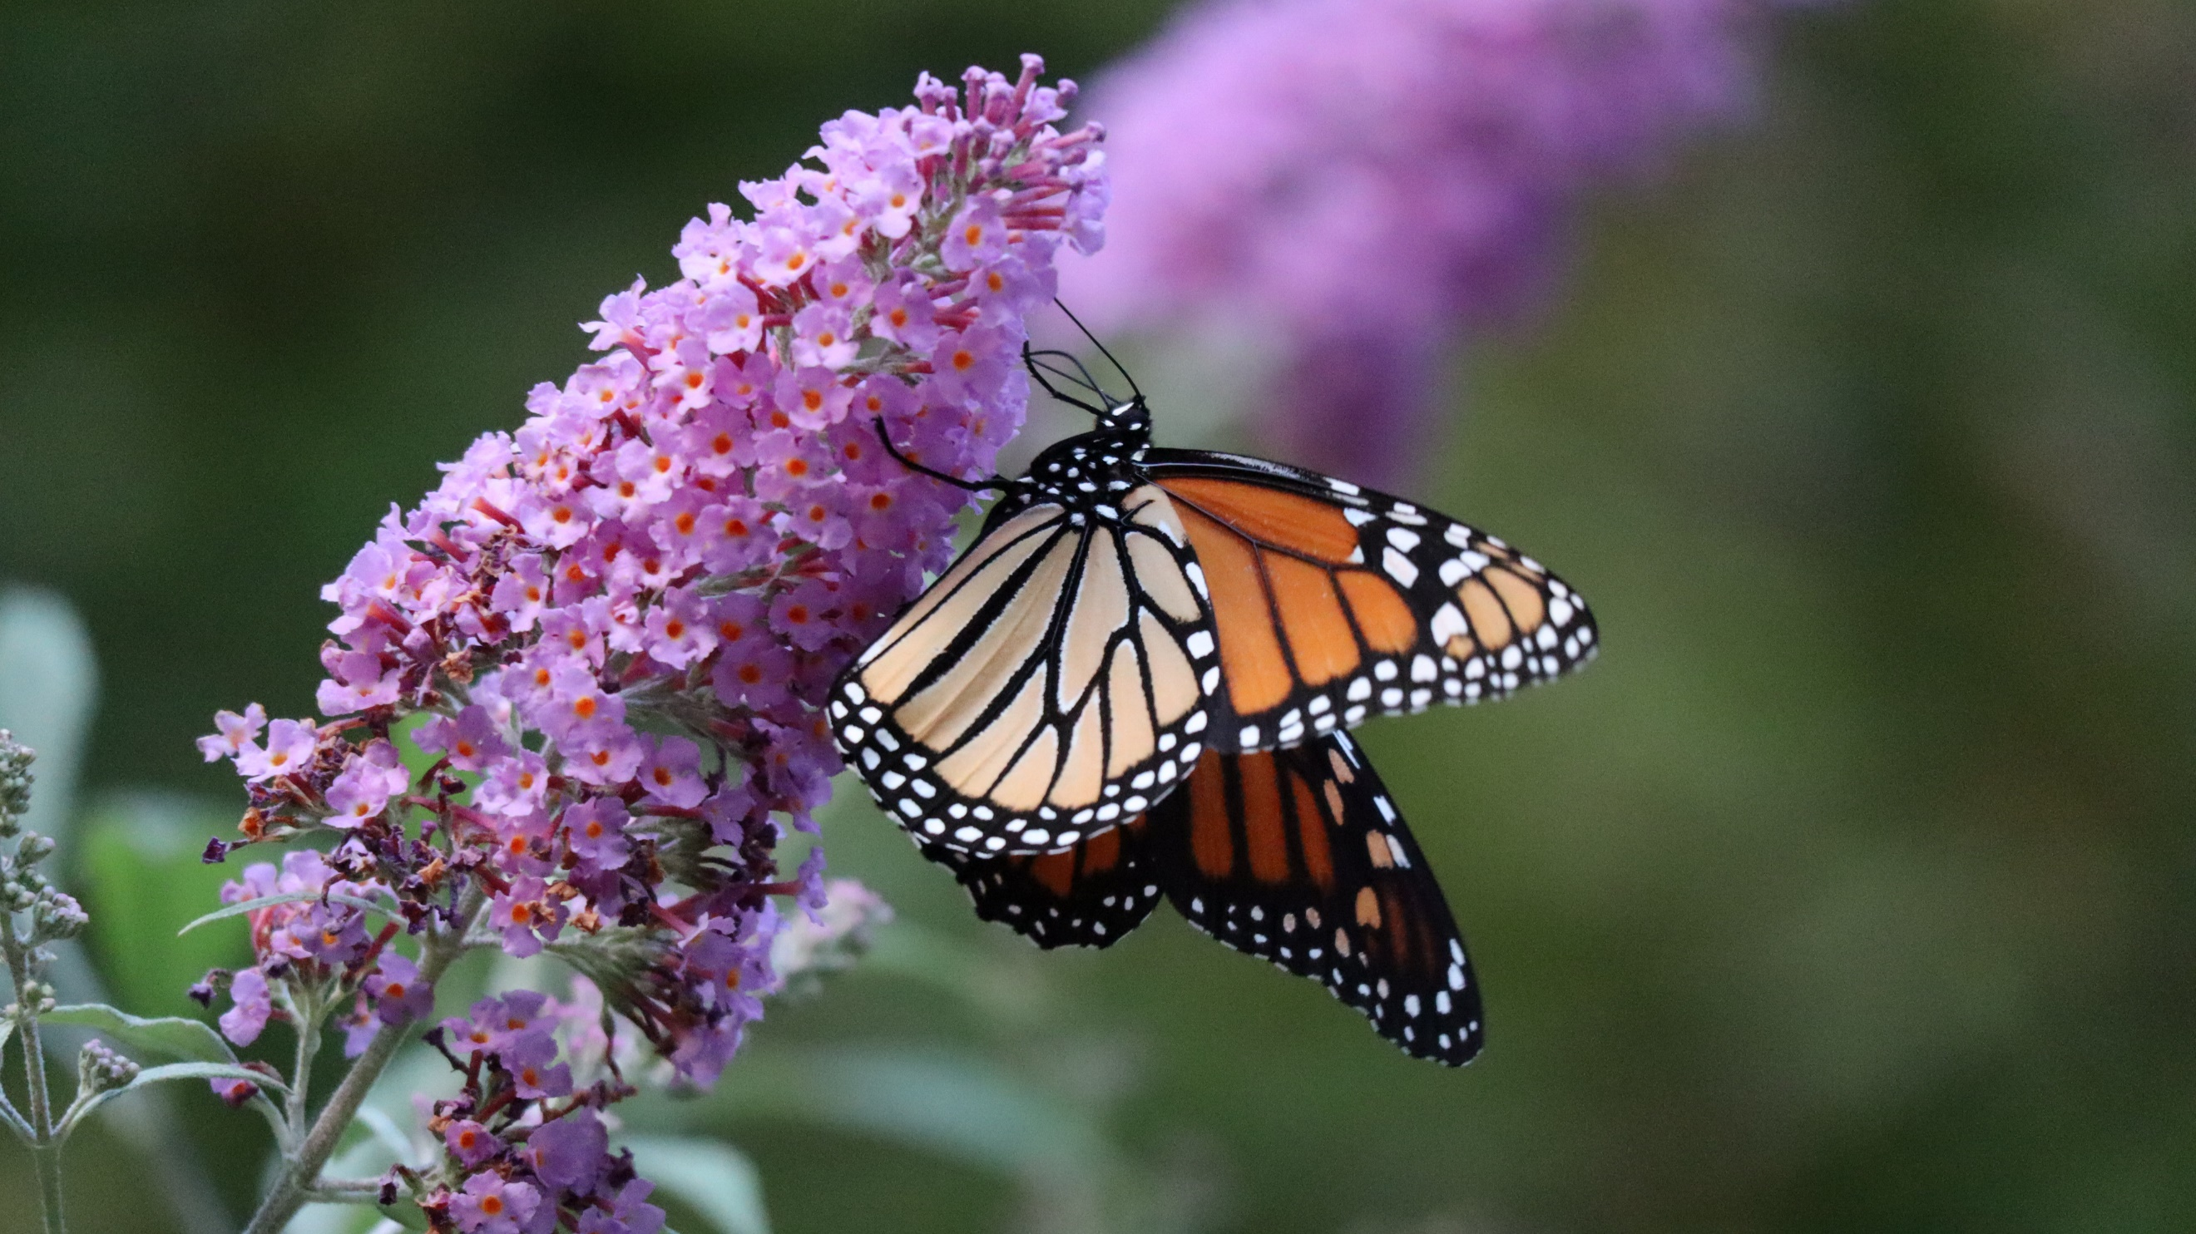
Fast Facts
Monarchs smell with their antennae.

Slide 5
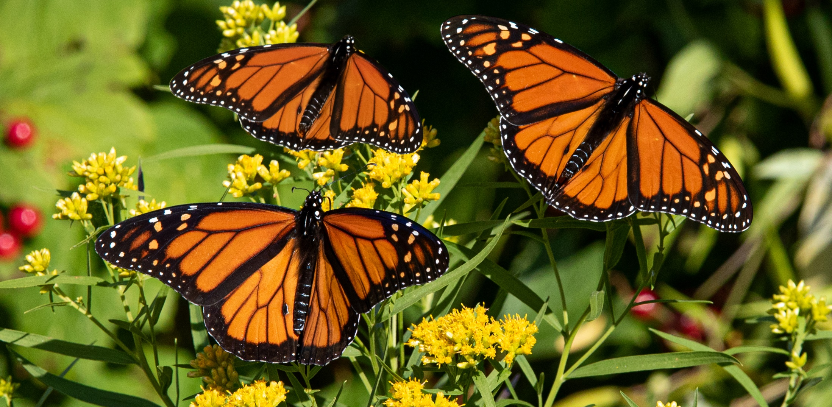
Fast Facts
The bright colors on the wings signal to predators that this butterfly is poisonous.

Slide 6
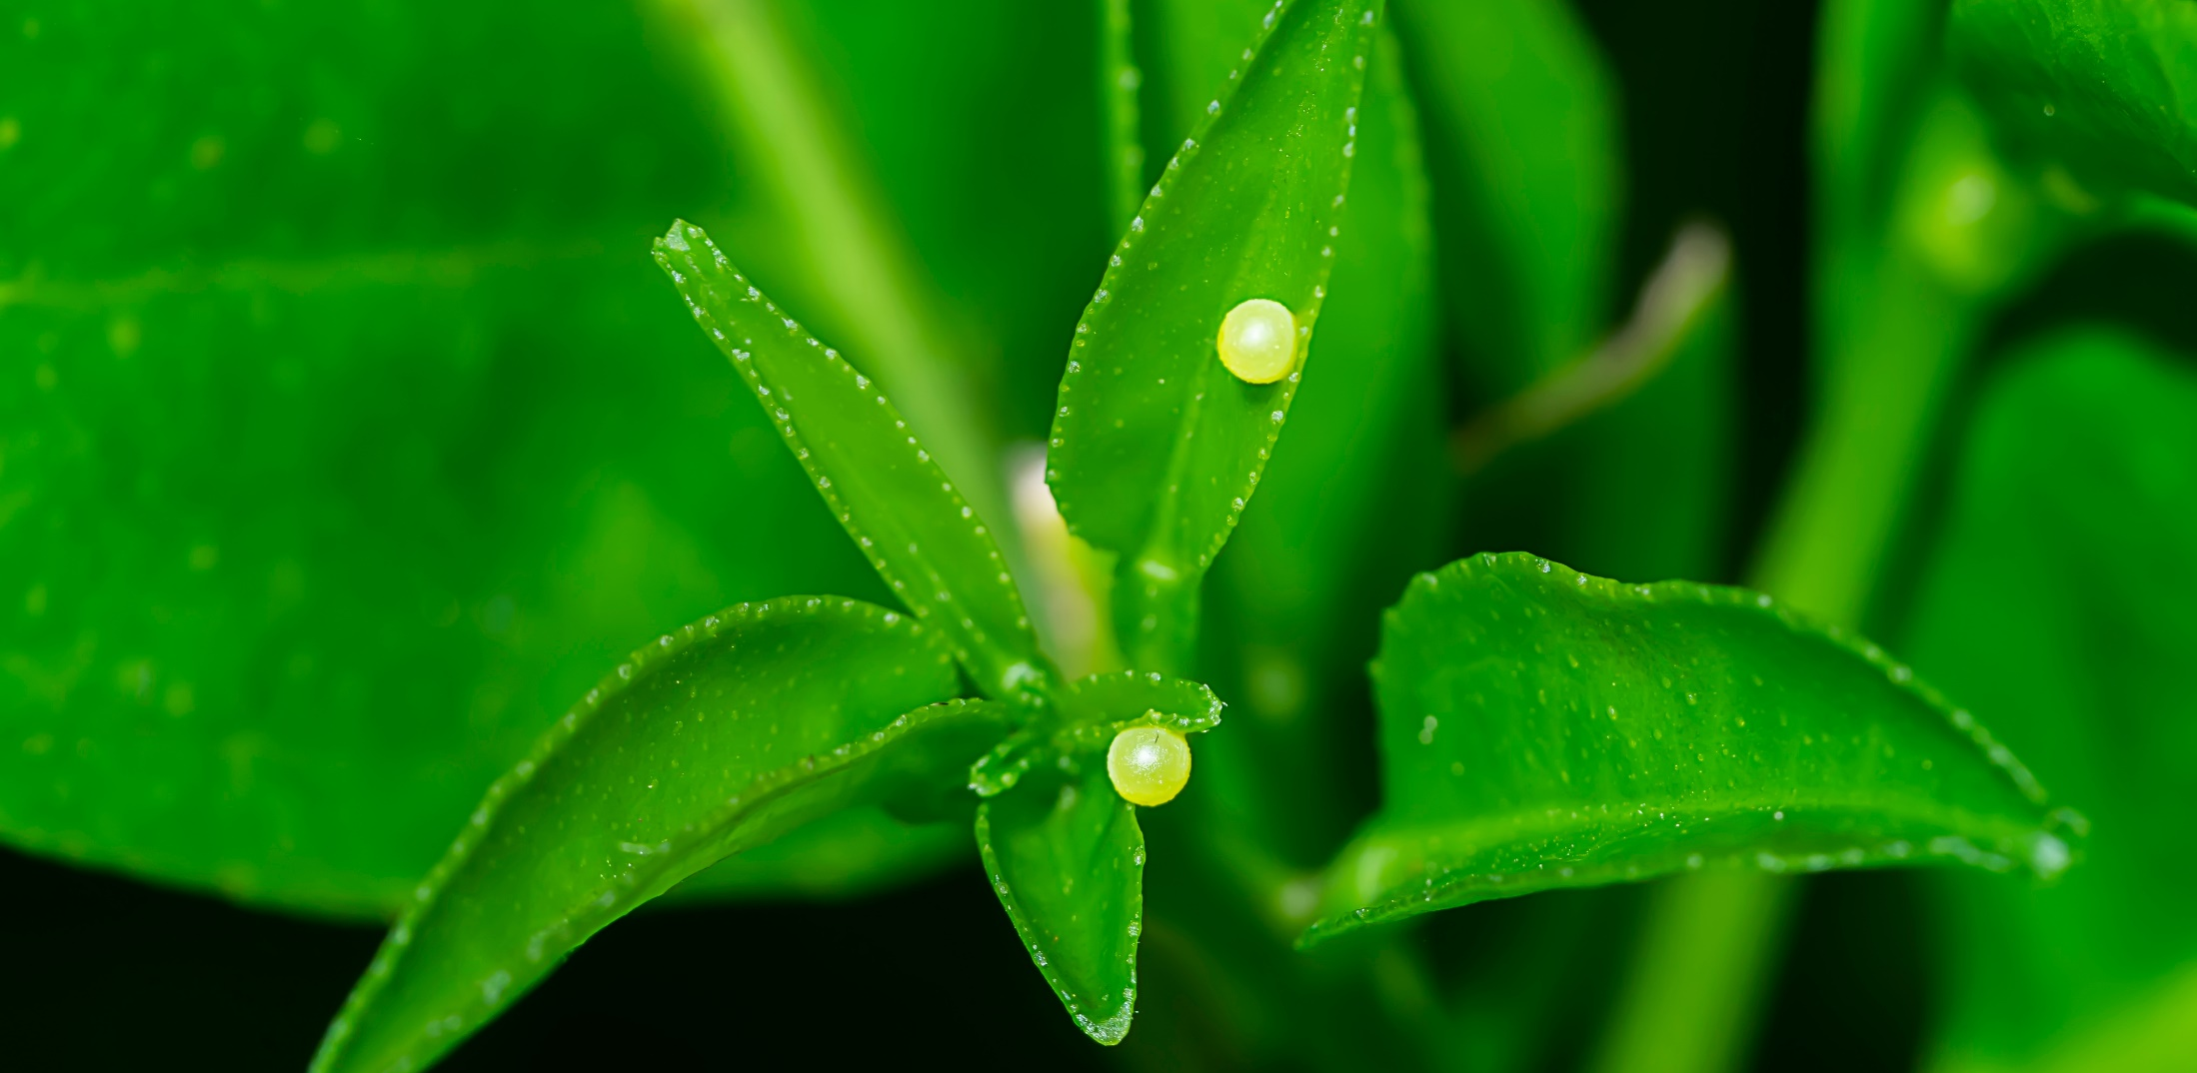
Fast Facts
A female monarch lays between 300 and 500 eggs over a two to five week period.

Slide 7
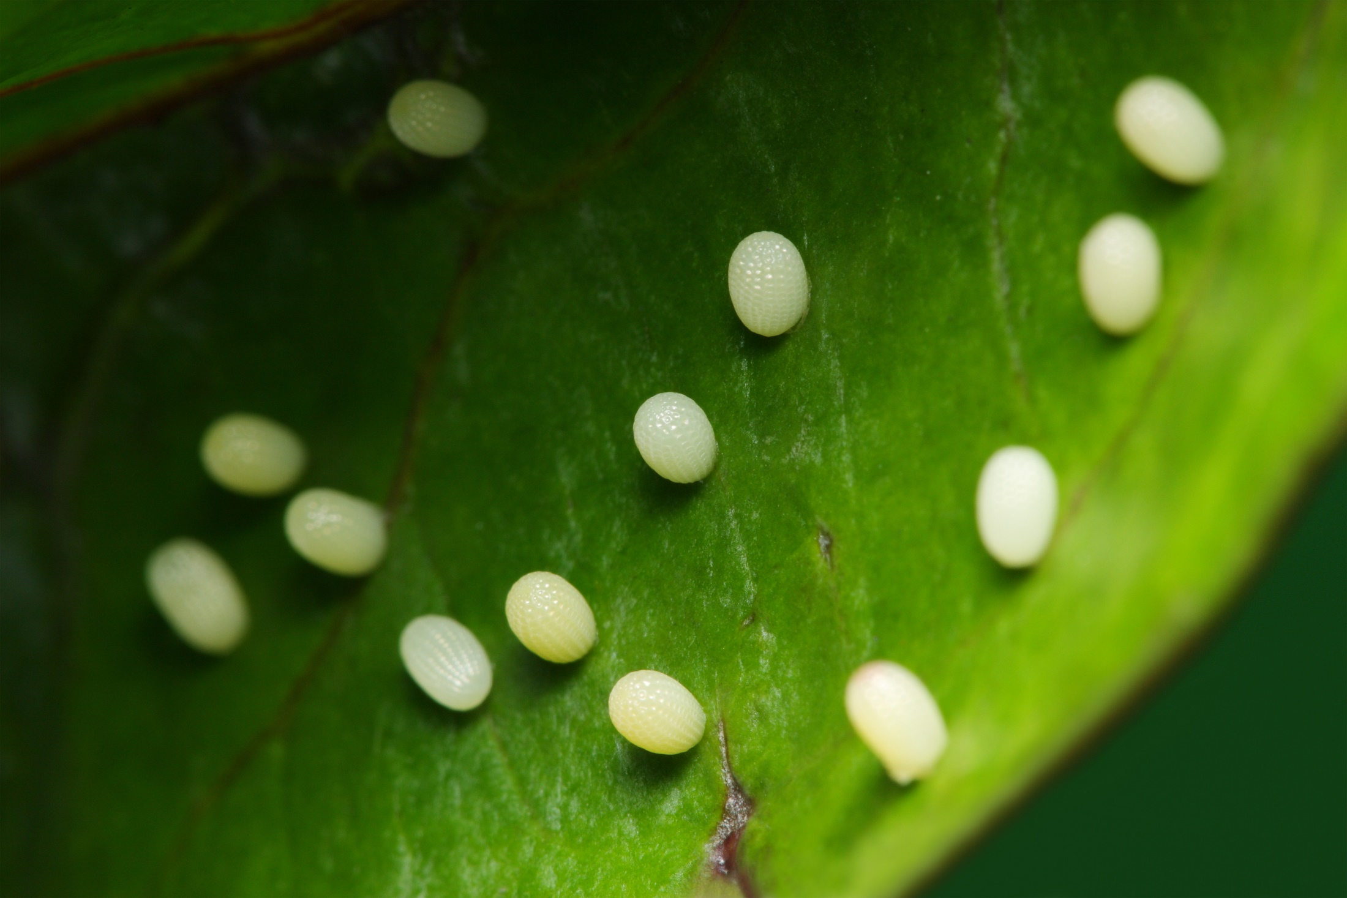
Fast Facts
A female monarch lays between 300 and 500 eggs over a two to five week period.

Slide 8
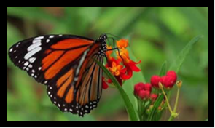
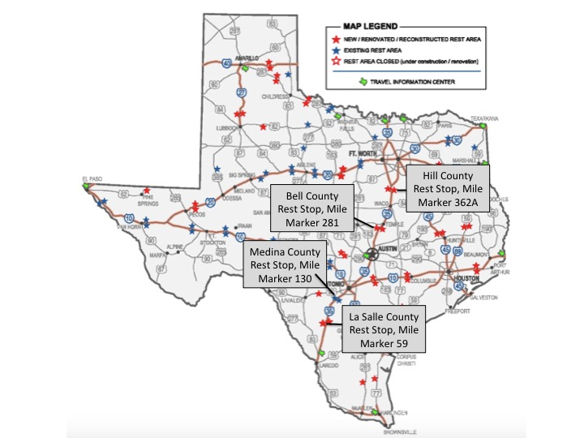
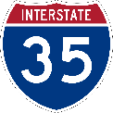
Find Out More
Click on the butterfly above to learn more about monarchs throughout the state!
Notes:
TxDOT has Monarch migration runs along I-35 through major cities in Texas like Fort Worth, Waco, Austin, San Marcos, San Antonio, Cotulla, and Laredo.
View Monarchs and other pollinators at TxDOT’s Safety Rest Areas along I-35:
Bell County, Mile Marker 281
Hill County, Mile Marker 362A
Medina County, Mile Marker 130
La Salle County, Mile Marker 59

Slide 9
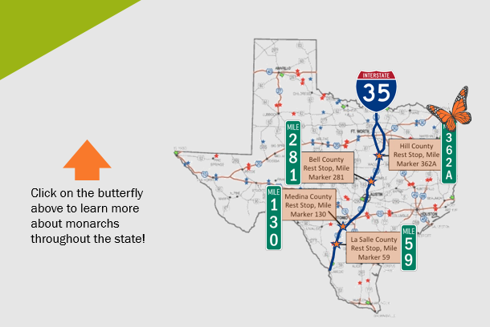
Find Out More
Notes:
TxDOT has Monarch migration runs along I-35 through major cities in Texas like Fort Worth, Waco, Austin, San Marcos, San Antonio, Cotulla, and Laredo.
View Monarchs and other pollinators at TxDOT’s Safety Rest Areas along I-35:
Bell County, Mile Marker 281
Hill County, Mile Marker 362A
Medina County, Mile Marker 130
La Salle County, Mile Marker 59

