Slide 1
Creating a Culture of Civility @Work in the Era of #MeToo & #TimesUp
Joe Bontke, M.Ed
EEOC Houston District Office
713651 4994 office
713 907 2855 cell joe.bontke@eeoc.gov
Notes:
The Growing Problem of Workplace Incivility: How to Reduce Rudeness, Encourage Courtesy & Create a More Professional Atmosphere
From raunchy reality shows to parent brawls at Little League games, incivility seems to be everywhere – so it's no surprise that rudeness has also invaded the workplace.
Squabbling employees, screaming managers, colleagues who never respond to emails, co-workers who send texts while you're talking to them… all these people seem to have forgotten the basic rules of courtesy and respect. Offensive behavior among colleagues carries a high price, because "civility" at work means more than just good manners. Respectful treatment creates the foundation for cooperation between individuals and collaboration among departments. When people are rude and disrespectful to one another, they are much less likely to share information, contribute helpful suggestions, or offer assistance with problems

Slide 2
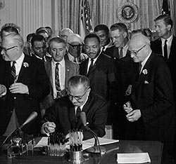
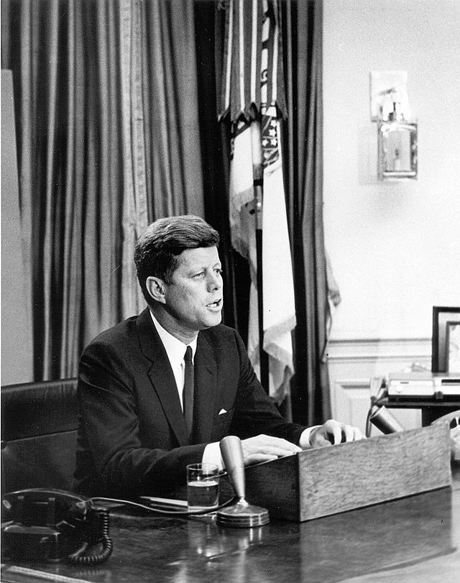
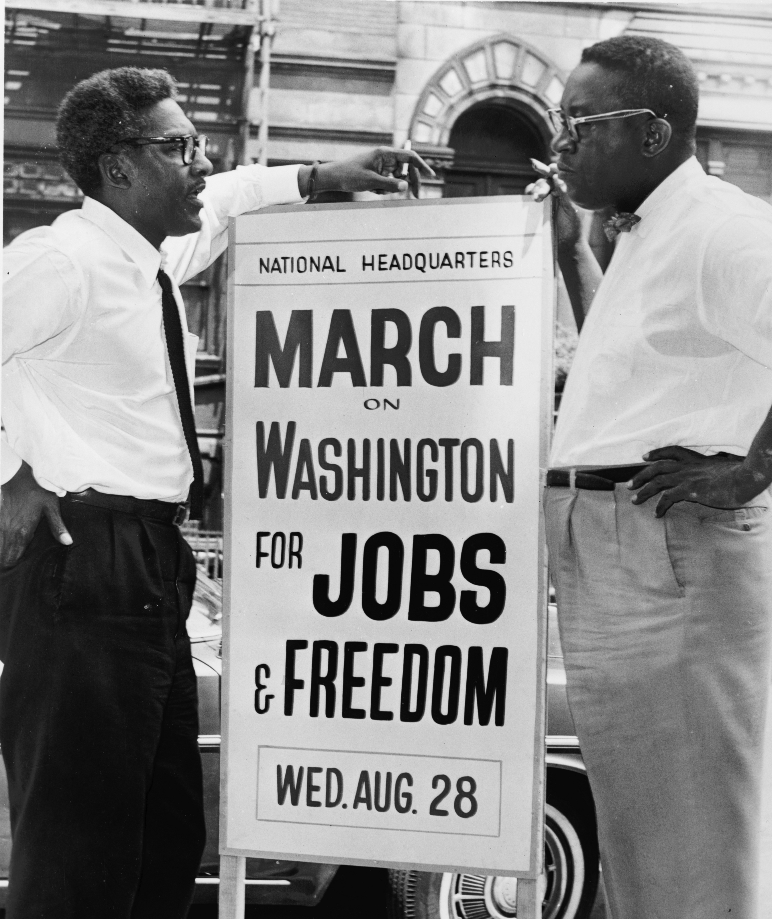
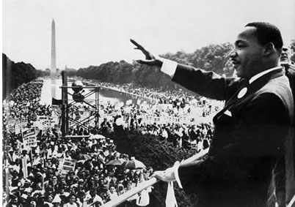
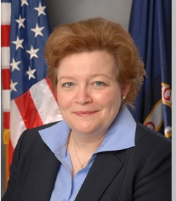
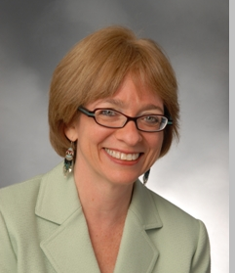
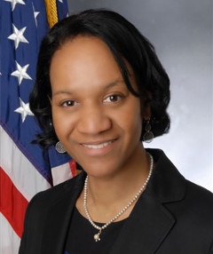
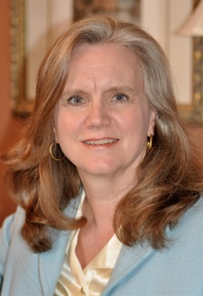
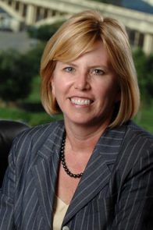
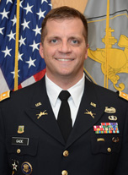
U.S. Equal Employment Opportunity Commission
Nominated Chair:
Janet Dhillon
Nominated:
Daniel Gade
Acting Chair: Victoria Lipnic
Chai Feldblum
Charlotte Burrows
Nominated:
General Counsel
Sharon Fast Gustafson
Notes:
EEOC was created over 50 years ago as part of the Civil Rights Act of 1964
independent regulatory commission enforcing federal anti-discrimination laws (employment only)
VISION Justice and Equality in the Workplace
MISSION Stop and Remedy Unlawful Employment Discrimination
HQ Washington, 53 field offices. 15 districts
SF District = N. California, N Nevada, Alaska, Washington, Oregon, Idaho, Montana.
Commission consists of five Senate-confirmed Commissioners.
No more than three Commissioners can be from the same political party.
Commissioners serve for set terms of 5 years.
Commission voted on a Strategic Enforcement Plan for 2017-2021.
Commission has a bipartisan commitment to enforcing the law and helping employers comply with the law.
Sharon Fast Gustafson is a solo practitioner in Arlington, Virginia. She received her J.D. from Georgetown University Law Center, cum laude, in 1991. After law school she worked for four years in the labor and employment law group at Jones, Day in Washington, D.C.
Ms. Gustafson now practices in Virginia, Maryland, and the District of Columbia. She advises and represents both employees and employers in employment-related legal matters. She was awarded Lawyer of the Year (2016) by the Metropolitan Washington Employment Lawyers Association. She is a member of the National Employment Lawyers Association and the Federal Bar Association.
Ms. Gustafson was counsel for Peggy Young in Young v. United Parcel Service, 2011 WL 665321 (D.Md.), aff'd, 707 F.3d 437 (4th Cir. 2013, rev'd and remanded, 575 U.S. ____, 135 S. Ct 1338 (2015).

Slide 3
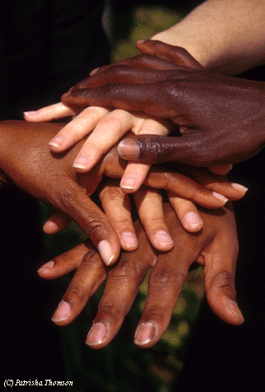
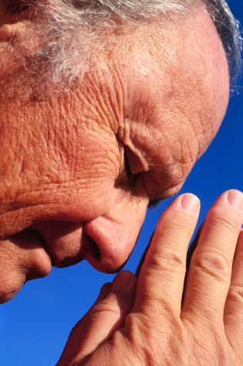
8 protected categories
religion
color
disability
race
genetic information
sex +
pregnancy
age (>40)
national origin
Notes:
failure to hire, termination, demotion, terms and conditions, failure to promote, failure to reasonably accommodate, hostile environment, retaliation, etc.
WHO IS PROTECTED?
employee
temporary worker
job applicant
former employee
some interns
undocumented workers too!
who can be liable?
employer
For most statutes, 15+ employees in 20 calendar weeks in the calendar year of discrimination or preceding year 20+ employees for ADEA 1+ for EPA
labor organization
temporary employment agency or staffing firm

Slide 4
Retaliation
EEOC statutes protect individuals who
Oppose an unlawful employment practice
File a complaint, testify, assist or participate in an investigation, proceeding or hearing concerning prohibited discrimination
Request a reasonable accommodation (religion or disability)
Notes:
All four statutes enforced by the EEOC prohibit retaliation
Adverse Actions: “anything that would chill employer from complaining”
Harassment and intimidation
Denial of employment benefits
Discharge, discipline, demotion, reassignment, denial of promotion
Unjustified evaluations and reports
Acceleration of disciplinary action
Undeserved negative reference

Slide 5
EEOC 2017 Charge Receipts by Type
Notes:
Here is another way of looking at our work (compare National & TX trends)

Slide 6
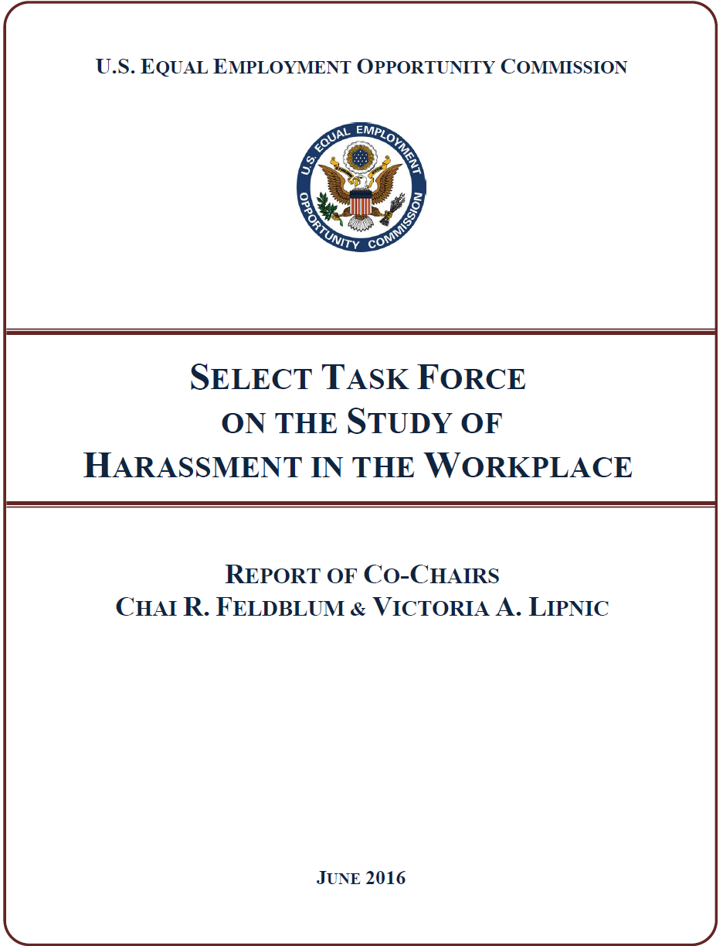
Rebooting Harassment Prevention
Harassment continues to be one of the most frequently raised complaint—
over 30% of all private sector cases
43% of Federal sector cases
#solveharassment
A Bipartisan Effort
Report available at:
www.eeoc.gov/task_force/ harassment/report.cfm
Notes:
Two Commissioners of the U.S. Equal Employment Opportunity Commission (EEOC), Co-Chairs of a Select Task Force on the Study of Harassment in the Workplace, called on stakeholders to double down and "reboot" workplace harassment prevention efforts at a meeting of the EEOC in Washington today. Commissioners Chai R. Feldblum and Victoria A. Lipnic highlighted for their fellow Commissioners the key findings and recommendations of a report they developed after 14 months of study of workplace harassment with the Select Task Force.
Convened in 2015, the Select Task Force was comprised of 16 members from around the country, including representatives of academia from various social science disciplines, legal practitioners on both the plaintiff and defense side, employers and employee advocacy groups, and organized labor.
Here are some point from the executive summery:
Workplace Harassment Remains a Persistent Problem. Almost fully one third of the approximately 90,000 charges received by EEOC in fiscal year 2015 included an allegation of workplace harassment. This includes, among other things, charges of unlawful harassment on the basis of sex (including sexual orientation, gender identity, and pregnancy), race, disability, age, ethnicity/national origin, color, and religion. While there is robust data and academic literature on sex-based harassment, there is very limited data regarding harassment on other protected bases. More research is needed.
Workplace Harassment Too Often Goes Unreported. Common workplace-based responses by those who experience sex-based harassment are to avoid the harasser, deny or downplay the gravity of the situation, or attempt to ignore, forget, or endure the behavior. The least common response to harassment is to take some formal action – either to report the harassment internally or file a formal legal complaint. Roughly three out of four individuals who experienced harassment never even talked to a supervisor, manager, or union representative about the harassing conduct. Employees who experience harassment fail to report the harassing behavior or to file a complaint because they fear disbelief of their claim, inaction on their claim, blame, or social or professional retaliation.
There Is a Compelling Business Case for Stopping and Preventing Harassment. When employers consider the costs of workplace harassment, they often focus on legal costs, and with good reason. Last year, EEOC alone recovered $164.5 million for workers alleging harassment –and these direct costs are just the tip of the iceberg. Workplace harassment first and foremostcomes at a steep cost to those who suffer it, as they experience mental, physical, and economic harm. Beyond that, workplace harassment affects all workers, and its true cost includes decreased productivity, increased turnover, and reputational harm. All of this is a drag on performance – and the bottom-line.
It Starts at the Top – Leadership and Accountability Are Critical. Workplace culture has the greatest impact on allowing harassment to flourish, or conversely, in preventing harassment. The importance of leadership cannot be overstated – effective harassment prevention efforts, and workplace culture in which harassment is not tolerated, must start with and involve the highest level of management of the company. But a commitment (even from the top) to a diverse, inclusive, and respectful workplace is not enough. Rather, at all levels, across all positions, an organization must have systems in place that hold employees accountable for this expectation. Accountability systems must ensure that those who engage in harassment are held responsible in a meaningful, appropriate, and proportional manner, and that those whose job it is to prevent or respond to harassment should be rewarded for doing that job well (or penalized for failing to do so). Finally, leadership means ensuring that anti-harassment efforts are given the necessary time and resources to be effective.
Training Must Change. Much of the training done over the last 30 years has not worked as a prevention tool – it’s been too focused on simply avoiding legal liability. We believe effective training can reduce workplace harassment, and recognize that ineffective training can be unhelpful or even counterproductive. However, even effective training cannot occur in a vacuum – it must be part of a holistic culture of non-harassment that starts at the top. Similarly, one size does not fit all: Training is most effective when tailored to the specific workforce and workplace, and to different cohorts of employees. Finally, when trained correctly, middle-managers and first-line supervisors in particular can be an employer’s most valuable resource in preventing and stopping harassment.

Slide 7
The EEOC concluded that trainings have failed as a prevention tool because they are “too focused on simply avoiding legal liability.”
Notes:
The EEOC concluded in a 2016 report that trainings have failed as a prevention tool because they are “too focused on simply avoiding legal liability.”
Last year, the EEOC’s task force on workplace harassment found only three studies that have evaluated the effectiveness of training programs over time at companies. And the most recent study on the subject was 15 years old.
“It was a jaw-dropping moment for some of us,” Victoria Lipnic, the agency’s acting chair, said.
An important question now: Will companies respond to the #MeToo movement by pouring more money into trainings or will they focus on developing other solutions?

Slide 8
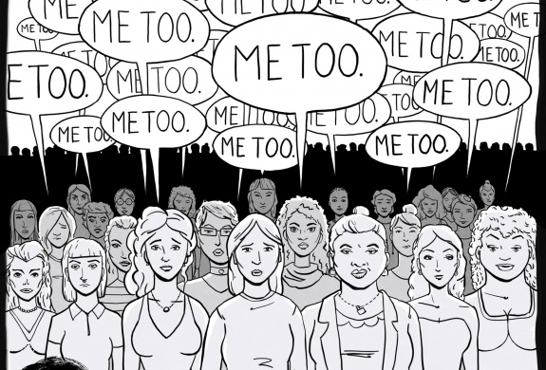
#MeToo
In October 2017, Harvey Weinstein, a very powerful producer in the movie industry for decades, was accused of sexual harassment by more than thirty women—
including famous
Gwyneth Paltrow,
Kate Beckinsale,
Ashley Judd,
Rose McGowan
Angelina Jolie
Notes:
From ADL.org
Weinstein is not the first famous person accused in recent years of sexual harassment. That list includes Bill Cosby, comedian, actor, and author; Roger Ailes, previous FOX News Chairman and others. They were accused by numerous women of sexual misconduct and have had resulting professional, financial and reputational setbacks. Further, the founder and CEO of Uber, was forced out amid allegations that he tolerated a company culture of sexual harassment.
A few days after the Weinstein allegations came to light, actress Alyssa Milano tweeted: "If you've been sexually harassed or assaulted, write 'me too' as a reply to this tweet.” The hashtag actually originated ten years ago by Tarana Burke, a survivor of sexual assault. After Milano tweeted the message, women in droves—some famous and many not—used #MeToo to share their experiences of sexual harassment and sexual assault that occurred over their lifetimes. These posts flooded Facebook, Instagram and Twitter; in less than 24 hours, there were over 12 million posts, comments and reactions in response to #MeToo.

Slide 9
If I don’t have to pay her equally, I wont have to treat her equally
https://www.youtube.com/watch?v=-dMoK48QGL8
Notes:
If the monkeys can see it why cant we?

Slide 10
#MeToo First it was a story. Then a moment. Now, months after women began to come forward in droves to accuse powerful men of sexual harassment and assault, it is a movement. Time magazine has named “the silence breakers” its person of the year for 2017, referring to those women, and the global conversation they have started.
Notes:
First it was a story. Then a moment. Now, two months after women began to come forward in droves to accuse powerful men of sexual harassment and assault, it is a movement.
Time magazine has named “the silence breakers” its person of the year for 2017, referring to those women, and the global conversation they have started.
The magazine’s editor in chief, Edward Felsenthal, said in an interview on the “Today” show on Wednesday that the #MeToo movement represented the “fastest-moving social change we’ve seen in decades, and it began with individual acts of courage by women and some men too.”
Movie stars are supposedly nothing like you and me. They're svelte, glamorous, self-­possessed. They wear dresses we can't afford and live in houses we can only dream of. Yet it turns out that—in the most painful and personal ways—movie stars are more like you and me than we ever knew.
In 1997, just before Ashley Judd's career took off, she was invited to a meeting with Harvey Weinstein, head of the starmaking studio Miramax, at a Beverly Hills hotel. Astounded and offended by Weinstein's attempt to coerce her into bed, Judd managed to escape. But instead of keeping quiet about the kind of encounter that could easily shame a woman into silence, she began spreading the word.
"I started talking about Harvey the minute that it happened," Judd says in an interview with TIME. "Literally, I exited that hotel room at the Peninsula Hotel in 1997 and came straight downstairs to the lobby, where my dad was waiting for me, because he happened to be in Los Angeles from Kentucky, visiting me on the set. And he could tell by my face—to use his words—that something devastating had happened to me. I told him. I told everyone."
She recalls one screenwriter friend telling her that Weinstein's behavior was an open secret passed around on the whisper network that had been furrowing through Hollywood for years. It allowed for people to warn others to some degree, but there was no route to stop the abuse. "Were we supposed to call some fantasy attorney general of moviedom?" Judd asks. "There wasn't a place for us to report these experiences."
Finally, in October—when Judd went on the record about Weinstein's behavior in the New York Times, the first star to do so—the world listened. (Weinstein said he "never laid a glove" on Judd and denies having had nonconsensual sex with other accusers.)
When movie stars don't know where to go, what hope is there for the rest of us? What hope is there for the janitor who's being harassed by a co-worker but remains silent out of fear she'll lose the job she needs to support her children? For the administrative assistant who repeatedly fends off a superior who won't take no for an answer? For the hotel housekeeper who never knows, as she goes about replacing towels and cleaning toilets, if a guest is going to corner her in a room she can't escape?
Like the "problem that has no name," the disquieting malaise of frustration and repression among postwar wives and homemakers identified by Betty Friedan more than 50 years ago, this moment is born of a very real and potent sense of unrest. Yet it doesn't have a leader, or a single, unifying tenet. The hashtag #MeToo (swiftly adapted into #BalanceTonPorc, #YoTambien, #Ana_kaman and many others), which to date has provided an umbrella of solidarity for millions of people to come forward with their stories, is part of the picture, but not all of it.
This reckoning appears to have sprung up overnight. But it has actually been simmering for years, decades, centuries. Women have had it with bosses and co-workers who not only cross boundaries but don't even seem to know that boundaries exist. They've had it with the fear of retaliation, of being blackballed, of being fired from a job they can't afford to lose. They've had it with the code of going along to get along. They've had it with men who use their power to take what they want from women. These silence breakers have started a revolution of refusal, gathering strength by the day, and in the past two months alone, their collective anger has spurred immediate and shocking results: nearly every day, CEOs have been fired, moguls toppled, icons disgraced. In some cases, criminal charges have been brought.
Emboldened by Judd, Rose McGowan and a host of other prominent accusers, women everywhere have begun to speak out about the inappropriate, abusive and in some cases illegal behavior they've faced. When multiple harassment claims bring down a charmer like former Today show host Matt Lauer, women who thought they had no recourse see a new, wide-open door. When a movie star says #MeToo, it becomes easier to believe the cook who's been quietly enduring for years.

Slide 11
Women in low-wage US farm jobs say #MeToo
Notes:
the Alianza Nacional de Campesinas, an organisation representing about 700,000 current and former farmworker women, published an open letter in solidarity with women who have come forward across the US to share stories of sexual harassment and assault.
Several women accused Hollywood producer Harvey Weinstein of sexual assault, and many more have come forward with stories of sexual abuse at the hands of powerful men working in media, politics, sports and other areas. Women from around the world have used the hashtag #MeToo on social media to share their experiences and show solidarity with one another
While many of the women coming forward worked in the US entertainment industry, Alianza wrote that its members - despite not working "under bright stage lights or on the big screen" - understood "the hurt, confusion, isolation and betrayal that you might feel.
"Even though we work in very different environments, we share a common experience of being preyed upon by individuals who have the power to hire, fire, blacklist and otherwise threaten our economic, physical and emotional security," their letter reads.
Farmworker women are especially vulnerable to sexual harassment and abuse at work because of "a severe imbalance of power" between employers and supervisors and the workers, many of whom are immigrants, according to a 2012 Human Rights Watch report.

Slide 12
A movement grows
Notes:
As stars line up on the red carpet and to collect Golden Globes in Beverly Hills on Sunday (Jan. 7), eagle-eyed viewers will note the plethora of couture ensembles have all been accessorized the same: Black and white pins bearing the phrase "Time's Up."
Time's Up is a new initiative created through a collective of about 300 women actors, "agents, writers, directors and entertainment executives to fight sexual misconduct across the country," according to The New York Times. It was developed in the wake of hundreds of women alleging sexual misconduct against a slew of notable men in entertainment and other industries, a trend set off after reports about similar accusations against Hollywood magnate Harvey Weinstein.

Slide 13
'Me Too' Series Exploring Sexual Harassment Set at PBS
Hosted by Zainab Salbi, the five-part series will dig deeper into the recent harassment headlines.
Debuting Feb. 2, #MeToo, Now What?
The series asks the question: How did we get here and how can we use this moment to effect positive and lasting change moving forward?
Notes:
Hosted by Zainab Salbi, the five-part series will dig deeper into the recent harassment headlines. The public broadcaster has ordered a new five-part series #MeToo, Now What? hosted by Zainab Salbi, the founder of humanitarian organization Women for Women International. The half-hour show will explore the topic at the forefront of the national conversation: the culture’s sexual harassment awakening.

Slide 14
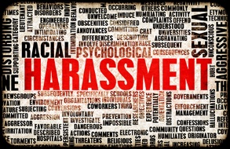

Slide 15
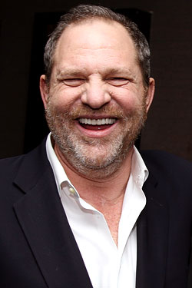
HIGH PROFILE

Slide 16
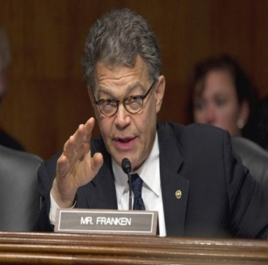
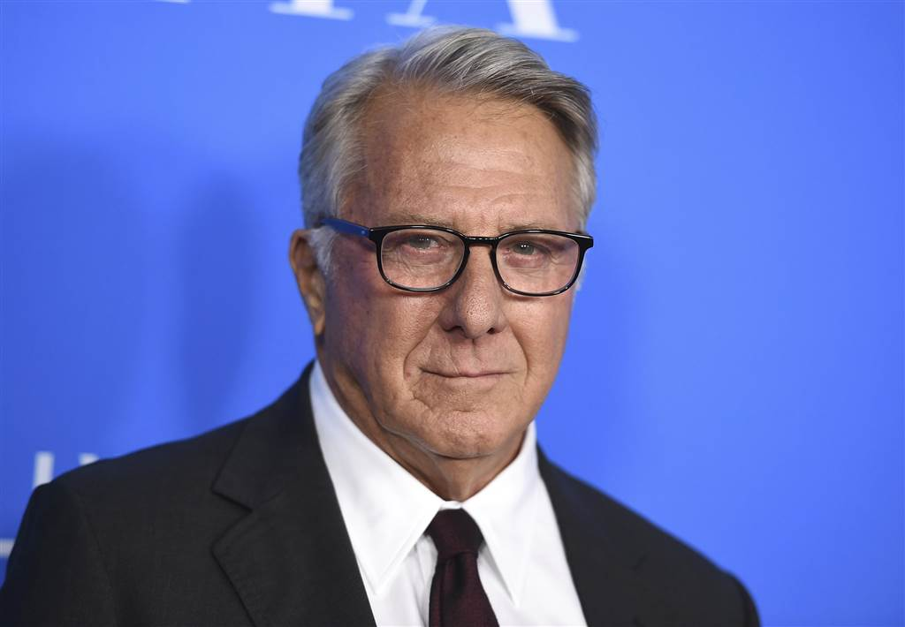
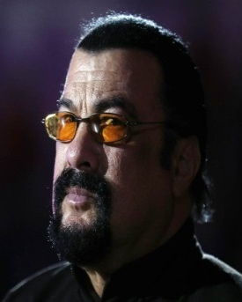
Since Weinstein Over 75 others accused
Notes:
l

Slide 17
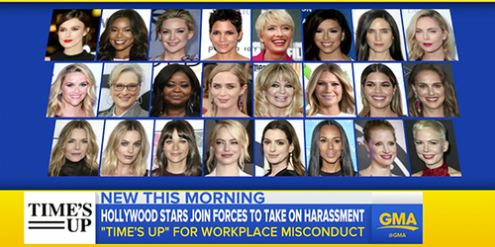
#TIMESUP

Slide 19
Select Task Force on the Study of Workplace Harassment
Purpose: To Examine Workplace Harassment
What do we know now?
How can we translate knowledge into action?

Slide 20
Harassment
Remains
A Persistent
Problem

Slide 21
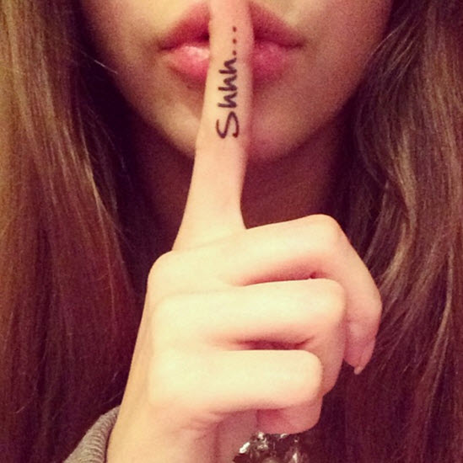
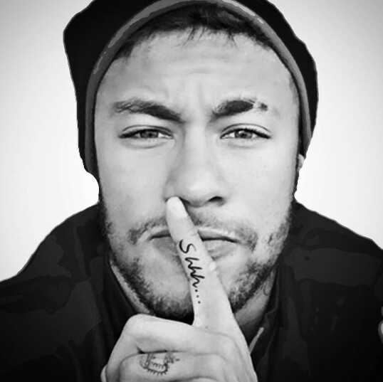
Workplace
Harassment Too
Often Goes
Unreported

Slide 22
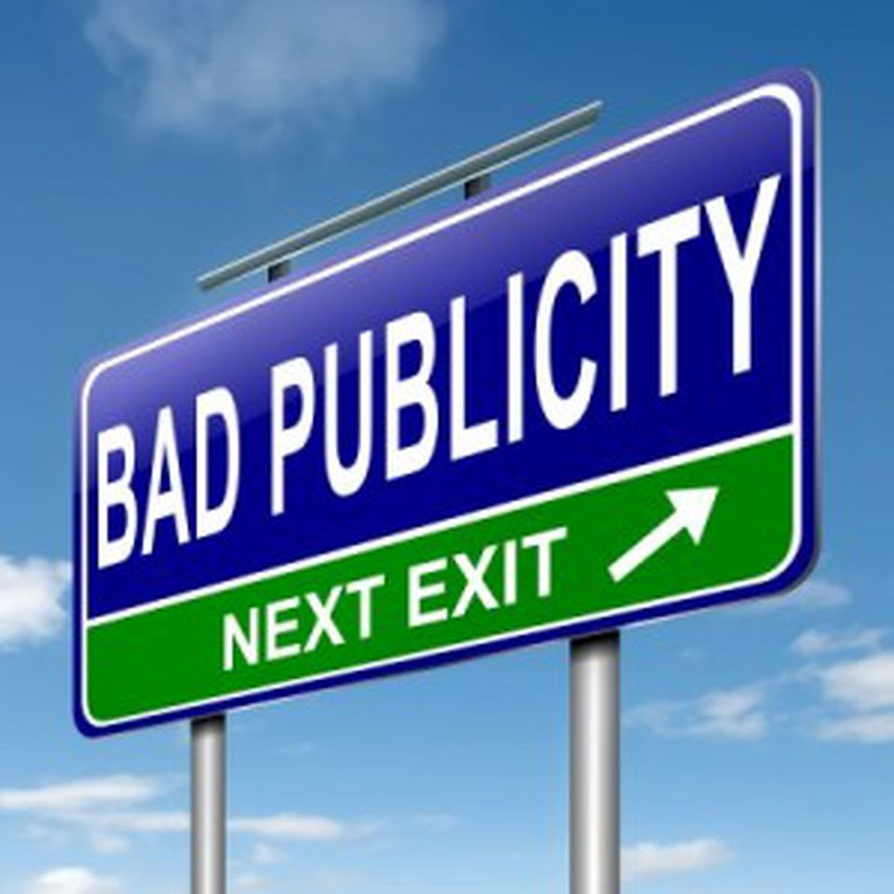
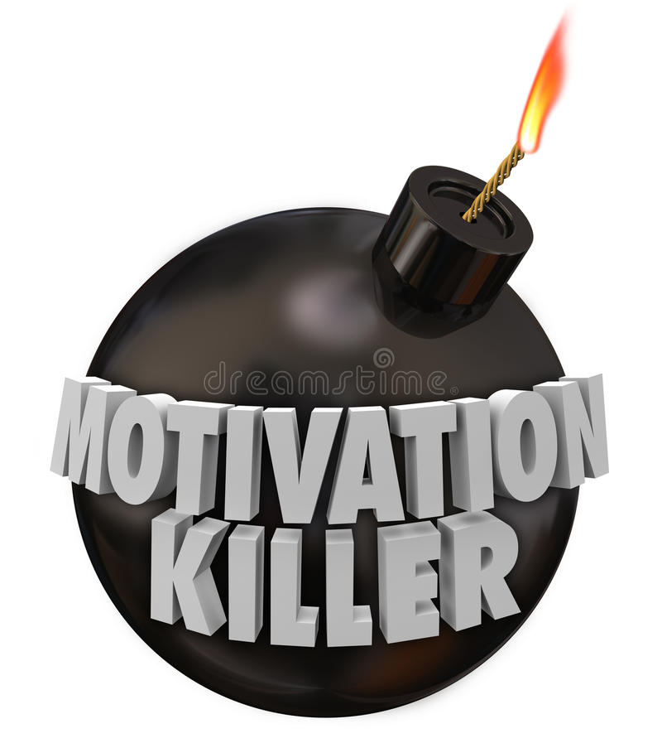
There is a Compelling
Business Case
For Stopping and
Preventing Harassment

Slide 23
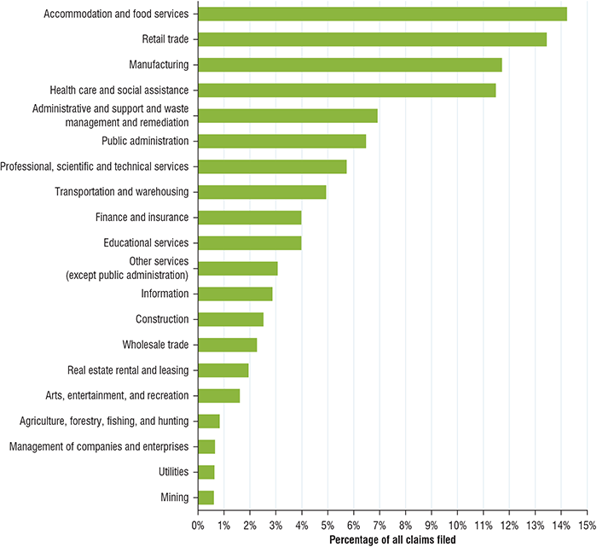

Slide 24
$949,700,000
Between FY2010 to FY2017, employers paid $949.7 million during EEOC’s pre-litigation enforcement process to employees alleging harassment.

Slide 25
Indirect Financial Costs
Health and workplace productivity of the target of harassment
Health and workplace productivity of coworkers who witness harassment
Job turnover
Reputational harm

Slide 26
The Perils of the Superstar Harasser
Employers often make a wrong cost-benefit
analysis when faced with allegations of harassment
against a highly valued employee.
Employers are often tempted to ignore misconduct
for fear of cost to the organization.
In reality, the cost of allowing harassment to go
unchecked is higher than the cost of losing a highly
valued employee.

Slide 27
It Starts at the Top

Slide 28
Leadership: It Starts at the Top
Awareness: Leadership knows about the prevalence of workplace harassment: e.g., via climate surveys.
Values: Leaders believe harassment is wrong and should not occur in the workplace. Leaders convey a sense of urgency in stopping and preventing harassment.
Accountability: Leaders address harassment in a swift, effective, and proportionate manner. Leadership holds managers accountable for stopping harassment.

Authenticity: Workers believe that leaders mean what they say.
Lemon drops oat cake oat cake sugar cake

Lemon drops oat cake oat cake sugar cake

Slide 29
Training Must Change

Slide 30
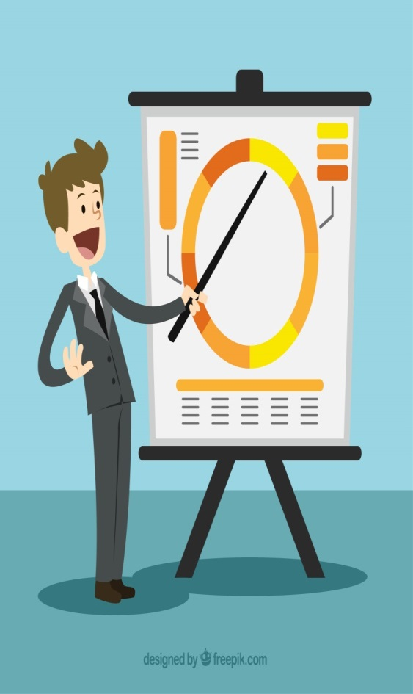
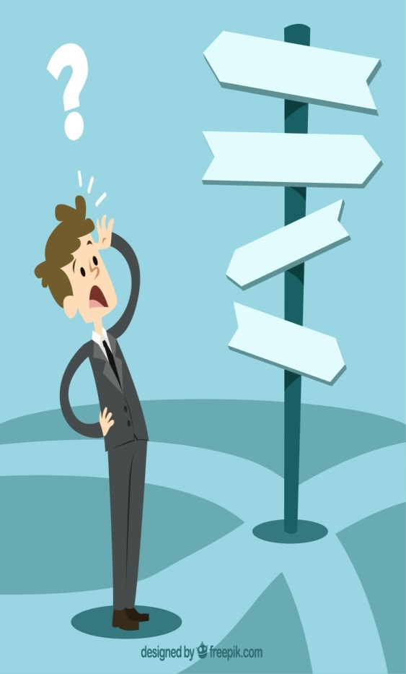
Problems with Traditional Harassment Prevention Training
There is some really bad training out there.
Training is sometimes done primarily to avoid legal liability.
Training is often done in a vacuum, not as part of a holistic harassment prevention effort.

Slide 31
Good Training
Training is essential, but it needs to
be the right training.
Compliance training is critical
and new types of training hold promise.
31

Slide 32
advice to those concerned about how doing business in the climate of #MeToo can affect them:
1.) Take complaints seriously and investigate
2.) Establish an anti-harassment policy
Notes:
It's important for employees of any company to speak up any time they feel harassed, Hannigan said, but it's just as important for the company to respond immediately.
"A company should — regardless of how long ago it was — launch into a formal investigation, which would be obtaining written statements and documents from the individuals involved in the specific situation, whether there were witnesses present or anyone who overheard or saw anything," Hannigan said.
"Until you’re able to obtain all that information, you’re really not able to determine if there truly was harassment involved or not."
The spotlight is shining most brightly now on famous women's claims against male colleagues, but Baker said men can be sexually harassed, too, and are not to be dismissed.
"It’s not only women that feel they are being harassed or have been in a situation where they feel uncomfortable," she said. "We have had men as well and I’ve been involved in investigations of those. We need to make sure that whomever is bringing these claims forward, that we’re treating them seriously and are investigating.
"I give a lot of kudos to those who do come forward, and are brave enough to do that."
Companies must outline clearly what is and isn't considered sexual harassment and ensure that information is given to employees, Hannigan said.
"The most important thing we’re really trying to address with our clients today is making sure that they have an anti-harassment policy in place and it’s up to speed," Hannigan said.
"It’s outlining what is considered harassment, what steps need to be taken if an employee files a harassment claim, processes, procedures, and outlining that an investigation will be conducted and that most importantly, there will be no retaliation against the employee who is bringing up the behavior to the employer."
Harassment can take many forms.
It could be standing too close to a coworker, touching another person, making lewd or suggestive jokes, sending sexual text messages or posts on social media, having a pinup on your desk or an inappropriate photo of a romantic partner.

Slide 33
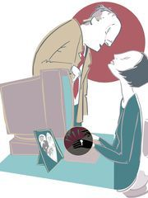
More advice to those concerned about how doing business in the climate of #MeToo can affect them:
3.) Get training, rinse, repeat
4.) Establish a reporting protocol
5.) Use the Grandma Test
Notes:
Once a company has established a policy, Hannigan and Baker say regular training about that policy is vital.
"We recommend annual trainings," Hannigan said, "and if there is any filing of a harassment claim of any sort, and an investigation is conducted, part of the resolution coming out of that investigation is a formal training for that staff again."
The training can be done during in-person meetings with the staff or remotely through training videos, online courses or PowerPoint presentations.
"It’s mainly just outlining what the appropriate and inappropriate behaviors are in the workplace and then also the steps the employee needs to take if they’re feeling that they’re harassed and then what the process will be from there," Hannigan said.
Managers and supervisors need to understand how their roles as leaders within a company carry greater responsibility to report anything that seems out of line, Baker said.
"From a supervisory or leadership perspective, what is their obligation? It is if you see something, say something," she said.
Outlined in any good sexual harassment policy is a procedure about how to report it, Baker said.
"In some cases it would be to report to the supervisor. If the person is uncomfortable going to the supervisor, then they could go to HR," she said.
"We have a lot of companies now that are requesting hotlines, an ethics or a reporting hotline, where if you are uncomfortable talking to anybody about what’s happening, you can call the hotline. We manage a lot of these for clients and we’ve seen an uptick of those as well."
The company's reporting protocol should be included in employee handbooks and referenced in regular training.
this climate of heightened climate of awareness, anyone concerned about whether his or her behavior at work is appropriate can try what Hannigan calls the Grandma Test.
"The biggest thing that people have to realize is the perception," she said. "You might think your actions are fine and OK, but that might not be how the other individual is perceiving it. And that’s all it’s going to take for them to feel comfortable or uncomfortable.
"You have to be mindful of your actions. Would you act or speak to your grandmother in that fashion? If not, you probably shouldn’t be doing it to your coworker."
As for that company president Hannigan said was concerned that false allegations of harassment could come from private meetings with female executives, Hannigan said he can try to have his meetings in an open forum, ask a third party to sit in on the meetings or, with the other person's permission, record the meetings.
"That’s not going to protect him fully because somebody could try to claim he was touchy-feely, but it would at least minimize any type of verbal harassment that could possibly take place," she said.

Slide 34
Civility
Be kind, for everyone you meet
is fighting a hard battle.
-- Plato or someone else
Notes:
Be Kind; Everyone You Meet is Fighting a Hard Battle
Plato? Philo of Alexandria? Ian MacLaren? John Watson?
This blog post is based on a question that was posed at the wonderful blog used by the quotation expert Fred Shapiro who is the editor of one of the best reference works in this area: The Yale Book of Quotations. Fred Shapiro’s posts appear on the Freakonomics blog.
Question: This question is from Glossolalia Black.
Be kind, for everyone you meet is fighting a hard battle.
It is attributed to Plato on this little thing I have up in my office, but I was told by a friend that it wasn’t him.
Fred Shapiro replied “this sounds anachronistic for Plato by almost 2500 years” and then invited readers to attempt to trace the quotation.
Quote Investigator: The websites ThinkExist, Quotations Page, and Brainy Quote do have this quotation listed under the august name of Plato.
Philo of Alexandria is another popular choice when assigning attribution, e.g., QuotationsBook credits Philo. Sometimes Anonymous gets the nod. QI was able to trace the saying back more than one-hundred years to its likely origin. The original aphorism did not use the word “kind”. Instead, another surprising word was used.

Slide 35
At age 14, George Washington compiled a list of “110 Rules of Civility & Decent Behaviour”…
Rule #6 –
Sleep not when others speak…
Sit not when others stand,
Speak not when you should hold your peace,
Walk not on when others stop.
Notes:
By age sixteen, Washington had copied out by hand, 110 Rules of Civility & Decent Behavior in Company and Conversation. They are based on a set of rules composed by French Jesuits in 1595. Presumably they were copied out as part of an exercise in penmanship assigned by young Washington's schoolmaster.
And he was President of the United States, but I would go there

Slide 36
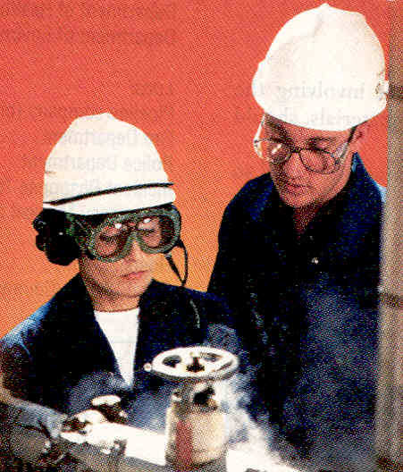
Workplace Civility
The Law & Liability
Hostile Work Environment
Title VII
Unwelcome behavior
related to a “protected class”
Discriminatory Behavior

Slide 37
EEOC Guidelines
Hostile or offensive work environment
When harassment is so pervasive that the working conditions are unduly oppressive
Applies to harassment based on any of the “protected classes”
Harris v. Forklift Systems
Quid pro quo
An employee’s submission to unwelcome sexual advances is an express or implied condition for receiving job benefits or the employee’s refusal to submit results in a job detriment
“This for that”
Applies to sexual harassment
Notes:
Harris v. Forklift Systems, Inc., 510 U.S. 17 (1993), is a case in which the United States of America Supreme Court clarified the definition of a "hostile" or "abusive" work environment under Title VII of the Civil Rights Act of 1964. In a unanimous opinion written by Justice Sandra Day O'Connor, the Court held that a determination about whether a work environment is hostile or abusive requires a consideration of all relevant circumstances.[1]
Teresa Harris was a manager at an equipment rental company, Forklift Systems Inc., between April 1985 and October 1987.^{[1]} Harris alleged that the president of Forklift Systems, Charles Hardy, subjected her to gender discrimination and undesired sexual innuendos while she was employed by the company. She claimed that these innuendoes included sexist remarks as well as sexual advance offers, and that these innuendos occurred on multiple occasions, and even in the presence of other employees^{[1]} Harris first complained about Hardy's behavior in August 1987. She complained directly to Hardy, and he claimed that he was kidding and apologized to Harris. After Harris complained, Hardy said that he would stop that kind of behavior, so Harris stayed at the job. However, in September, Hardy started harassing her again in front of other employees. Harris got her paycheck and quit her job at Forklift Systems, Inc. on October 1. After quitting, Harris sued Forklift Systems, Inc. Harris claimed that Hardy's behavior made an abusive work environment for her based on her gender.^{[1]}
Harris filed a lawsuit under Title VII of the Civil Rights Act of 1964. The United States District Court for the District of Tennessee stated that Hardy's behavior did not make a cruel work environment for Harris. The District claimed that Hardy's conduct would have made any "reasonable woman" uncomfortable but would not have affected their psychological well being and performance at work.^{[1]} The District Court held that the evidence presented by Harris was not sufficient enough to show that Hardy's behavior actually affected the conditions of her employment; therefore, there was no Title VII violation.^{[1]} The United States Court of Appeals affirmed the District Court's decision.^{[2]}

Slide 38
Civility
Civility’s defining characteristic is its ties
to city and society. The Latin civitas means city, especially in the sense of civic community.
Notes:
Fun fact

Slide 39
Notes:
Pier Massimo Forni (born 1952[1]), a native of Italy, is an award-winning professor at Johns Hopkins University, where he has taught since 1985.[2] Dr. Forni has published several books, including his 2002 best-seller Choosing Civility: The Twenty-Five Rules of Considerate Conduct.[3] He co-founded and currently directs the Civility Project at Johns Hopkins,[4] the purpose of which is to assess the significance of civility, manners and politeness in contemporary society.

Slide 40
Life is a Relational Experience
The quality of our lives depends on the quality of our relationships.
Whether we like it or not, we are wax upon which others leave their mark.
Pier Massimo Forni
Notes:
Pier Massimo Forni (born 1952[1]), a native of Italy, is an award-winning professor at Johns Hopkins University, where he has taught since 1985.[2] Dr. Forni has published several books, including his 2002 best-seller Choosing Civility: The Twenty-Five Rules of Considerate Conduct.[3] He co-founded and currently directs the Civility Project at Johns Hopkins,[4] the purpose of which is to assess the significance of civility, manners and politeness in contemporary society.

Slide 41
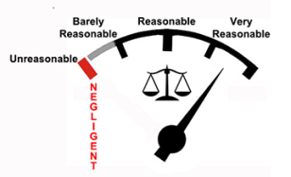
Social Skills Strengthen Social Bonds
Our happiness depends on the health and strength of our social bonds.
Social skills are a main determinant of our destiny.
Civility, far from being trivial or marginal to our lives is an extraordinarily effective tool for the building of a better, more meaningful, and healthier life.
P M Forni
Notes:
Common sense
Common sense is sound practical judgment concerning everyday matters, or a basic ability to perceive, understand, and judge that is shared by ("common to") nearly all people. The first type of common sense, good sense, can be described as "the knack for seeing things as they are, and doing things as they ought to be done." The second type is sometimes described as folk wisdom, "signifying unreflective knowledge not reliant on specialized training or deliberative thought." The two types are intertwined, as the person who has common sense is in touch with common-sense ideas, which emerge from the lived experiences of those commonsensical enough to perceive them.
Reasonable Person. A phrase frequently used in tort and Criminal Law to denote a hypothetical person in society who exercises average care, skill, and judgment in conduct and who serves as a comparative standard for determining liability.

Slide 42
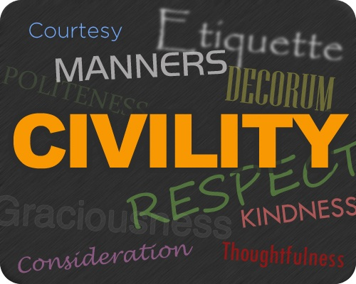
Defining Civility
Civility is a form of benevolent awareness.
Respect
Restraint
Consideration
Notes:
What does benevolent Awareness mean? The original meaning of the word benevolent comes from the Latin ‘bene’ and ‘volent’ which together mean “wishing well for all”. In other words it is about being willing to be aware of what one’s actions create for everyone. We can be benevolent leaders in our personal lives as well as in our relationships and family. We can choose to be benevolent leaders in any other area of life, be it at work or in our various communities

Slide 43
The Three Arguments for Civility
Principle of Respect for Persons
Connection between Incivility and Violence
Civility as a Quality of Life issue
Notes:
Respect for persons is the concept that all people deserve the right to fully exercise their autonomy. Showing respect for persons is a system for interaction in which one entity ensures that another has agency to be able to make a choice. This concept is usually discussed in the context of research ethics
Civility is not trivial, because it allows us to be ethical agents in the most common of situations. To put it more simply, civility does the everyday busy work of goodness.
Civility, health and quality of life: Imagine a supervisor harshly upbraiding a worker in the presence of colleagues - and then the upbraided worker retaliating by making the supervisor look bad in front of the boss at the first opportunity. This kind of uncivil behavior happens all the time. It is disruptive and stress-inducing - and can affect the health of employees and businesses.

Slide 44
Examples of Workplace Incivility
Interrupting others without care
Not listening
Disrupting meetings, inappropriate behavior at meetings
Rumoring, gossiping about or damaging a co-worker’s reputation
Perching impatiently over someone’s desk, waiting for undivided attention
Quoted from Envisonworks, Inc.

Slide 45
Dealing with Difficult Co-Workers
People are difficult because they either have too high or too low an opinion of themselves.
Suggest you need the person’s help to solve the problem.
Try to build the confidence of the difficult person.
Choose your battles.
Talk to a supervisor or Human Resources if the problem persists.
Notes:
More on coaching later

Slide 46
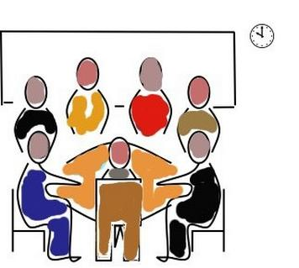
Effects of Workplace Incivility
Lowered morale of the employees
Reduced workplace citizenship behaviors (littering, carelessness with handling equipment and facilities, not taking care of others, etc.)
Reduced team effectiveness
Being uncivil to customers, clients, or others outside the immediate organization, office or facility
http://www.citehr.com/

Slide 47
Your Personal Outlook: “Life-Enhancer” or “Well-Poisoner”
Are others hearing from you:
what you can’t do
what you don’t have
what won’t work
Or are they hearing:
what you can do
what you do have
what will work
Half empty
Half full

Slide 48
Workplace Civility
What is “Civility”?
Clearly, civility has to mean something more than mere politeness. The movement will have accomplished little if all it does is get people to say, “excuse me please”, while they (figuratively) stab you in the back. Civility also cannot mean “roll over and play dead.”
- - The Meaning of Civility
Guy & Heidi Burgess, 1997

Slide 49
CIVILITY
Politeness
Respect
Affirmation
Morality
Connection
Accountability
Assertiveness
The Golden Rule
Manners
Tolerance
Self-Restraint
Focus
Public Health
Quality of Life

Slide 50
Negative Behaviors
Behavior whose purpose is to control, insult, humiliate, denigrate, embarrass, or injure the dignity of colleagues
Scape-goating
Backstabbing
Constant complaining
Perpetuating rumors
Being expected to do another’s work (clean up after them)
Behaviors which undermine team cohesion, staff morale, self worth and safety
Unethical or dishonest behavior
Ineffective, nonproductive forms of conflict resolution,
Repeated failure to respond to requests
Lack of respect, and/or
Cultural bias

Slide 51
So What is a Microaggression?
Microaggression: Subtle, verbal and nonverbal slights, insults, indignities, and denigrating messages directed toward an individual due to their group identity, often automatically and unconsciously. Usually committed by well-intentioned folks who are unaware of the hidden messages being communicated.
Notes:
JANET- 30 SEC

Slide 52
So What is a Microaggression?
Microaggressions are similar to carbon monoxide - “invisible, but potentially lethal” - continuous exposure to these type of interactions “can be a sort of death by a thousand cuts to the victim”
Sue, (2010) Microaggressions in Everyday Life: Race, Gender, and Sexual Orientation.
Notes:
JANET - 30 SEC

Slide 54
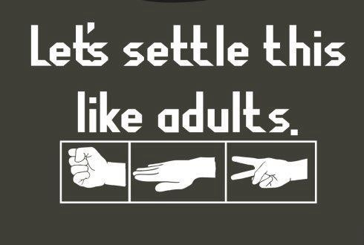
Why can't we all just get along?
Notes:
this question, as many of you may remember, was asked in the worst of circumstances by a man severely beaten during an arrest. But many of us ask this question on a daily basis. In personal and family relationships, in schools and at work, interactions among people are often fraught with disagreements. In workplaces, despite our best efforts, we frequently become involved in serious and ongoing interpersonal disputes. These disagreements may involve conflicts with supervisors or with other employees. To help make our daily work life more enjoyable, it is important for all of us to understand what causes interpersonal conflicts and how to revolve them.

Slide 55
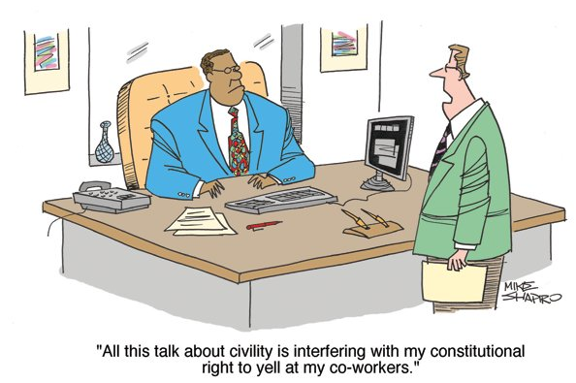
Notes:
Personal favorite
Do we have freedom of speech @ work?

Slide 56
“If we leave the human factor out of our business calculations,
we shall be wrong every time.”
William H. Lever, founder of Lever Brothers
www.tncwr.org
Notes:
Remember the “H” in HR
Business impact of doing so
One way to build competitive advantage and reduce legal liability for your organization is to improve the health status and well-being of your employees. “
Wellness – physical and mental

Slide 57
Business Case for Civility
Recruiting
Productivity
Customer Service
Presenteeism
Morale
Retention
Communication
Bottom Line
Notes:
Why SHOULD we care about civility?
Organizations with healthy workplace cultures have employees that get along.
When employees respect each other, and have healthy relationships with one another, they make better decisions, are more innovative, and learn more.
That translates into employee engagement, and when you have engaged and loyal employees you have reduced turnover and absenteeism.
Reduced turnover means better quality and quantity of work, and better customer service.
Better work and happy customers means meeting organizational goals, and that means BOTTOM LINE RESULTS!
One study found that both men and women would rather pursue a job with a supportive organization, even if that meant accepting less compensation.
Global consulting firm, Watson Wyatt, study - companies that openly promote civility among employees earn 30% more revenue than competitors, are 4 times more likely to have highly engaged employees, and are 20% more likely to report reduced turnover.
Stocks of the public companies on Fortune magazine’s “100 Best Companies to work For” list produced more than 3 times the gains of the broad market over the last 7years. The study suggests a strong link between workplace culture and a business’s financial performance...
CONVINCED?
If you aren’t, maybe you will be when we look at what it costs our organization

Slide 58
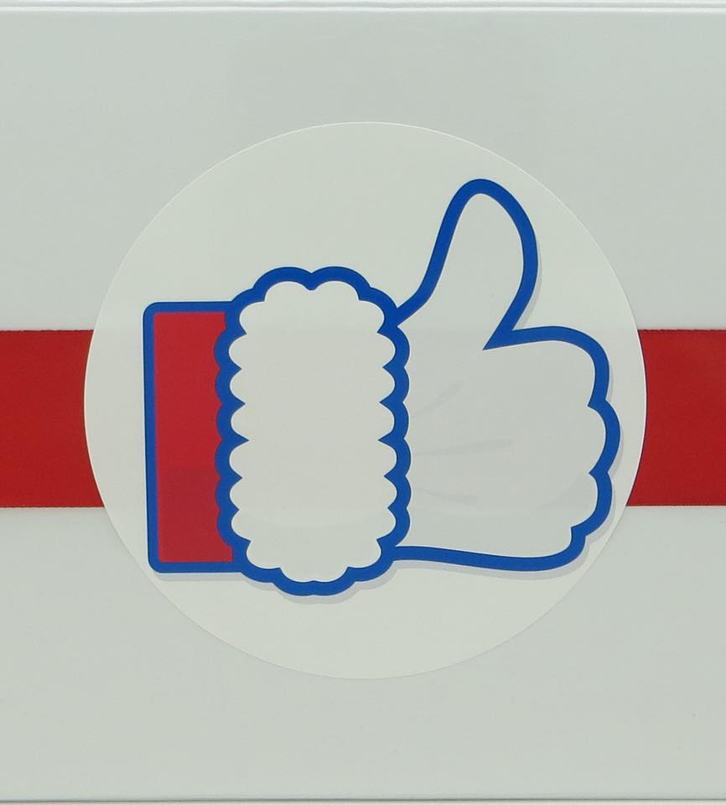
The Costs of Incivility
Turnover
Lost productivity
Accidents
Absenteeism
Customer complaints
Waste
Costs
Notes:
SHRM Incivility Rising article -
Study concluded that rudeness can have pervasive effects that permeate right to an organization’s bottom line.
Turnover - Can drive high-potential employees away
Mistakes
Quality
(Especially critical in healthcare setting)
Employees might treat your customers they way they are being treated
Incivility to customers
Public image
Reputation
New customers
Customer retention/loyalty
Waste – ASK AUDIENCE
Time, Material, Resources
Time Lost
-Gossip
Time spent in HR alone.
• Counsel
• Hold meetings with decision makers to determine what to do to resolve the problem
• Conduct investigations when grievances are filed
• Discipline the perpetrators of the negative behavior
• Interview, recruit, and train replacements
Tangible Costs – ASK AUDIENCE
Health insurance costs
Litigation – get expensive
Work comp
Intangible Costs
Think creativly
Impairs critical thinking and cognitive skills.
Creates:
Fear
Mistrust
Sets example – how behave to get ahead
Lost trust

Slide 59
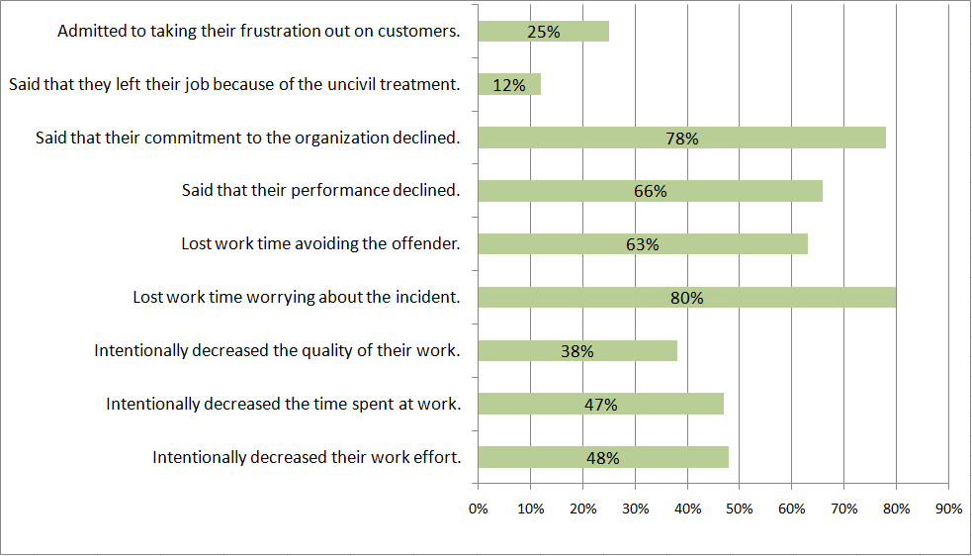
Notes:
Many managers would say that incivility is wrong, but not all recognize that it has tangible costs.
Poll of 800 managers and employees in 17 industries - how people’s reactions play out among workers who’ve been on the receiving end of incivility:
COMMON DECENCIES

Slide 60
What words come to mind, when you think of incivility?
Notes:
What come to mind
Lets list them

Slide 61
Cursing
Threats
Sabotage
Lying
Complaining
Belittling
Intimidation
Interrupting
Checking phone during meetings
Threats
Rudeness
Bullying
Dirty looks
Condescending comments
Disruptive at meetings
Public reprimands – makes me cringe
Silent treatment
Nasty emails
Undermining colleagues credibility
www.tncwr.org
Notes:
Ever heard the phrased “rip him a new one”
What types of behaviors are we talking about? ASK AUDIENCE
Cursing
Threats
Sabotage
Lying
Complaining
Belittling
Intimidation
Interrupting
Checking phone during meetings
Threats
Rudeness
Bullying
Dirty looks
Condescending comments
Disruptive at meetings
Public reprimands – makes me cringe
Silent treatment
Nasty emails
Undermining colleagues credibility
Why?
Why are people behaving so badly? Why are we reading about incivility in the workplace more now than ever?
AUDIENCE – ANY IDEAS?
MEMORIZE (WALK AROUND):
Employment market
Egos
Stress
Politics
Competition
Jealousy
Insecurity
Hidden agendas
Low self esteem
Emotions
Prima dona’s – thinking rules don’t apply to them
Problems at home
Current economic climate
Workloads – higher demand
Burnout
Fewer resources
POWER – Abuse of
It is what it is
However - Won’t go away if it is tolerated or condoned

Slide 62
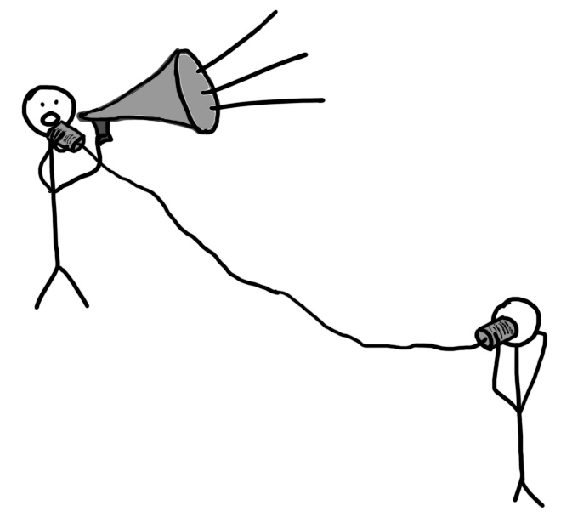
Why are we reading about incivility in the workplace more now than ever?
Employment market
Egos
Stress
Politics
Competition
Jealousy
Insecurity
Hidden agendas
Low self esteem
Emotions
Prima dona’s – thinking rules don’t apply to them
Problems at home
Notes:
In reading a recently published article in the McKinsey Quarterly, ‘The Hidden Toll of Workplace Incivility’ by Christine Porath, I was struck by the correlation between my own experience and what the research cited in the article asserted. Incivility in the workplace is on the rise. Personally, for over 30 years I have seen a gradual but constant decline in the “conscience” of the workplace, the unwritten rules we employ to maintain respect in our daily interactions. I am not talking about being politically correct, simply civil towards our co-workers.
If there is one thing I know, and I’d ask you to check with yourself on this, when I feel respected I am open to participate and collaborate, when I do not, I hold back and more than that, think about ways to level the playing field. That’s a nice way of saying that I look to find occasions to get even when I have been offended

Slide 63
the way we have always done it!
https://www.youtube.com/watch?v=0_u8sF1sW4A
Notes:
If you always do what you’ve always done you will always get what you've always got

Slide 64
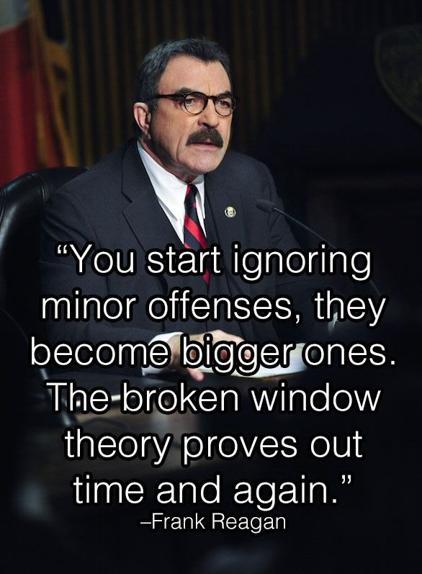
Broken Window Theory
www.tncwr.org
Notes:
Malcolm Gladwell
The Tipping Point
Broken windows theory of crime control – Wilson & Kellogg’s
Property upkeep plus reduction of petty crimes like graffiti reduce incidence of more violent crimes
Crime is the inevitable result of disorder
Famous experiment conducted 27 years ago by the Stanford University psychologist Philip Zimbardo:
2 cars – same condition
1 parked on a street in Palo Alto - sat untouched for a week
Identical car parked in a roughly comparable neighborhood in the Bronx - only in this case the license plates were removed and the hood was propped open
(First “vandals” were a family – father, mother, and young son – who removed the radiator and battery.)
Within 24 hours, the car in the Bronx was stripped
Windows smashed in, parts torn, upholstery ripped, children using car as playground
Palo Alto car sat untouched for more than a week.
In a final twist, Zimbardo himself smashed one of the Palo Alto car's windows with a sledgehammer
Within a few hours, that car, too, was destroyed.
Noted that the adult “vandals” in both cases were primarily well dressed, clean-cut, and respectable looking.
Zimbardo's point was that disorder invites even more disorder - that a small deviation from the norm can set into motion a cascade of vandalism and criminality
The broken window was the tipping point.
Similar events can occur in any civilized community when communal barriers – the sense of mutual regard and obligations of civility – are lowered by actions that suggest “no one cares.”
---------------------------------------
Window broken in apt.
Left broken.
Something else gets broken.
Isn’t fixed.
Graffiti starts to appear.
More damage accumulates.
People walking by conclude that no one cares and that no one is in charge.
More windows broken.
Damage spreads to street.
Sends signal that anything goes.
Whole neighborhood decays.
People move out.
Crime moves in.
A successful strategy for preventing vandalism - fix the problems when they are small. Repair the broken windows within a short time, say, a day or a week, and the tendency is that vandals are much less likely to break more windows or do further damage. Clean up the sidewalk every day, and the tendency is for litter not to accumulate (or for the rate of littering to be much less). Problems do not escalate and thus respectable residents do not flee a neighborhood.
Ripples in a pond

Slide 65
Counterproductive Workplace Behaviors Continuum
Incivility
Bullying
Violence
Notes:
When negative behaviors fester, rise to the level of bullying – destructive form of interpersonal abuse
Draw the line at dignity, professionalism, and mutual respect
Resolving disagreements cooperatively and constructively
Set boundaries
Focus on building a positive workplace instead. A culture of positivity and civility will push the bad behaviors out.

Slide 66
Notes:
Lifted from the ADL.org
In U.S. schools, fears of extremism, radicalization and mass violence have become all too familiar. It is important that schools, too, feel a sense of power that there is something they can do about those fears and realities. Among other things, they can understand and reflect on the precursors to violent activity, identify warning signs and refer young people to specific and appropriate support, create safe communities of learning that includes anti-bias programs and provide resources for students who are targets of bias and bullying.

Slide 67
Don’t Cross the Line
Harassment
Discrimination
Hostile Environment
Bullying
Civility
www.tncwr.org
Notes:
Draw the line at dignity, professionalism, and mutual respect
Goes above and beyond compliance – harassment, discrimination
Draw the line at resolving disagreements cooperatively and constructively
Set boundaries
Everyone contributes to the organization’s success
Instead of attempting to end violence, harassment and workplace bullying, focus on building a positive workplace instead. A culture of positivity and civility will push the bad behaviors out.
Let’s talk about bullying

Slide 68
The wrongly accused question
employers conduct a fair, thorough, and even-handed investigation of sexual harassment allegations
an investigation that is as fair to the alleged harasser as it is to the alleged victim.
BUT the percent of men wrongly accused is low so lets fix the bigger problem first
Notes:
There is an article
https://www.lexology.com/library/detail.aspx?g=b0b8b200-64cd-4510-a305-7578fc8429a4
The current attention to sexual harassment should not cause employers to dispense with conducting a fair, thorough, and even-handed investigation of sexual harassment allegations – an investigation that is as fair to the alleged harasser (who, after all, may be innocent) as it is to the alleged victim. And even if harassment is substantiated, not every act of workplace harassment is a termination offense. The bawdy joke, or the clumsy “compliment” that makes reasonable women cringe, may be corrected with a counseling and guidance about how to behave in the future, coupled with a low-level disciplinary warning

Slide 69
80% of bullying is legal, but still occurs.
Notes:
Bullying is rarely illegal
Legal solutions are rarely satisfying
Illegal discrimination occurs in 20% of bullying cases.
80% of workplace bullying is legal , but still occurs
“Bullying is the sexual harassment of 20 years ago; everybody knows about it, but nobody wants to admit it.
Lewis L. Matlby
President, National Workrights Institute
Case example of legal bullying
Frye v St. Thomas
----------------------------------------------
Ms. Frye (Target) was allegedly bullied by a manager at St. Thomas, who was forced to transfer – “I should be at work. I should be doing my job. I'm a good employee. I've always been a good employee.” And if it had not been for her harassing, demeaning, bullying, vicious, vile and vindictive behavior, I'd be at work, and I'd be contributing to Saint Thomas.
And I am just-I am devastated. I don't know if I'll ever work. I don't know if I'll ever go back again. I don't know when I'll return and it's because of her and the people that have ratified and supported her in her vendetta against me for all this time because she is a weak and shame-faced child who cannot deal with her own inadequacies, who is threatened by anybody who knows anything she doesn't know.
According to the deposition of Mr. Venuto, the bully dealt with all St. Thomas employees in her “intense” and “dominant” management style regardless of the age of the employee.
The hostile work environment in which Mrs. Frye found herself was not discriminatory and provides no basis for her alleged causes of action.
In reviewing the record, we agree with the trial court that Plaintiffs failed to establish a prima facie case of age discrimination because there is no evidence that Mrs. Frye was subject to discrimination because of her age nor was she subjected to an adverse employment action.
---------------------------------------
Sometimes mistreatment is based on discrimination due to race, gender, ethnicity, religion, disability, or age. Based on those categories, some people enjoy protected status by law.
Still resulted in pain and agony
Negative company exposure
Costs –time, money

Slide 70
How to Create a Civil Workplace
Create a vision
Create systematic plan of action
Make the case
Involve employees
Core values
Policies and codes of conduct
www.tncwr.org
Notes:
If leaders are not present WHY?
Make business case to senior management
Have a conversation about what leadership really means.
How incivility not good for business.
How civility ties to core values
How incivility creates legal risk.
In order for a positive culture to exist, leadership at all levels needs to be on board. Start talking to leaders about what leadership means in your organization, and guide them into understanding that leadership means support, empathy, civil communication… in addition to achieving results. That in fact, you can’t have the latter without the former
Cultivate mid-level leadership
Solicit employee input
Focus groups
Put the “not nice” person in charge
Vision and values building exercise:
Ask employees what the organizational culture is now, and what it should be.
Ask them to help define values statements – a list of specific behaviors (“thou shalts”) that will help you reach the vision.
At first this sounds cumbersome, but it’s not.
Everyone, no matter where they work, wants the same things, no matter what industry or size of organization they work for.
The values list will no doubt include trust, respect, accountability, friendliness, and other such civil behaviors, no matter what type of organization is completing this exercise.
This vision and values activity will create buy-in to culture change, so this is an important step.
Clearly, permitting bullying type of behavior, without regard to whether it is technically illegal, is not a good human resources practice. It should be the goal of every employer to make their own workplace bully-free.
Three steps that employers can take include:
Make sure your policies prohibit all harassing conduct; Respond to all complaints of improper behavior, even if it is not technically illegal, in the same way as you respond to a complaint of harassment based on a protected category; and Make sure that your actions are aligned with your words.
Note: This article was published in the May/June 2008 issue of The Employment Law Authority.

Slide 71
How to Create a Civil Workplace - Implementation
Train
Conflict management
Conflict resolution
Stress management
Teamwork
Interpersonal Communication
www.tncwr.org
Notes:
Add tools to their skills toolbox
Teach civility
Train ee’s and managers to recognize and respond to early signals
To create a positive workplace, it is necessary to tell employees what the expected behavior is.
Specifically, what behaviors do you want to see?
Help them understand the behaviors that contribute to a positive workplace culture.
At the very least, training should remind employees and managers that they have a responsibility to contribute to achieving a healthy and civil work environment that does not tolerate negative behaviors.
Under the umbrella of positivity –optimism, resilience, emotional intelligence, controlling stress, team work, and altruism, for example – are very powerful.
Conflict management – Our research indicated that those with a collaborative style of conflict management are less likely to engage in uncivil behaviors. – SHRM Incivility Rising article
Conflict resolution - Compromise
Train – managers and employees
Orientation
Onboarding
These are valuable skills that promote a healthy workplace.
WHAT ELSE?

Slide 72
How to Create a Civil Workplace - Implementation
Leaders model civility for others
Branding
Continual communication
Put it in writing
www.tncwr.org
Notes:
Look in the mirror to make sure modeling the right behavior
Walk the walk – leaders must be vigilant in modeling and establishing desired standards
Open to feedback
Holds self accountable first
Mentoring
Forgiveness
No more culture of blame and shame
Don’t look the other way – top performers, top producers, relatives
Same standards
Branding
Employees are ambassadors
Even those who leave
Applicants
Customers – good experience
Anyone who comes in contact with your company
Continual communication
Newsletter
Staff meetings
Emails
Goals
Vernacular
Replace negative terms – discipline, errors, investigations
Positive terms – accidents, analysis
Policy = Guideline
Documents
Performance evaluations,
Employee handbooks,
job plans,
job descriptions
360 reviews
Certain behaviors are a part of the job.

Slide 73
How to Create a Civil Workplace - Implementation
Recruit for behaviors
Reward the right behavior
Performance management
Reduce stress
www.tncwr.org
Notes:
Recruit
Critical to screen potential ee’s for cultural fit.
Ask relationship-based questions
Check References – former supervisors
Weed out trouble before it enters the organization
Reward
Create reward program
Promotions
Salary increases
Perks
Performance Management
Accountability – have to be willing to hold everyone accountable
Expectations regarding these behaviors tied to performance and career advancement and show up in employee goals and awards
programs.
Tie corrective action to core values
Weave values into daily performance expectations.
Reduce Stress
Evalute workloads – overwork one of the biggest causes; try not to pile too much on any one person
Flexibility
Work-life balance
Encourage ees to take vacation – not like a badge of honor
Working remotely
Exit interviews
Break the “why” down
what’s causing the stress
Ask
Wellness surveys

Slide 74
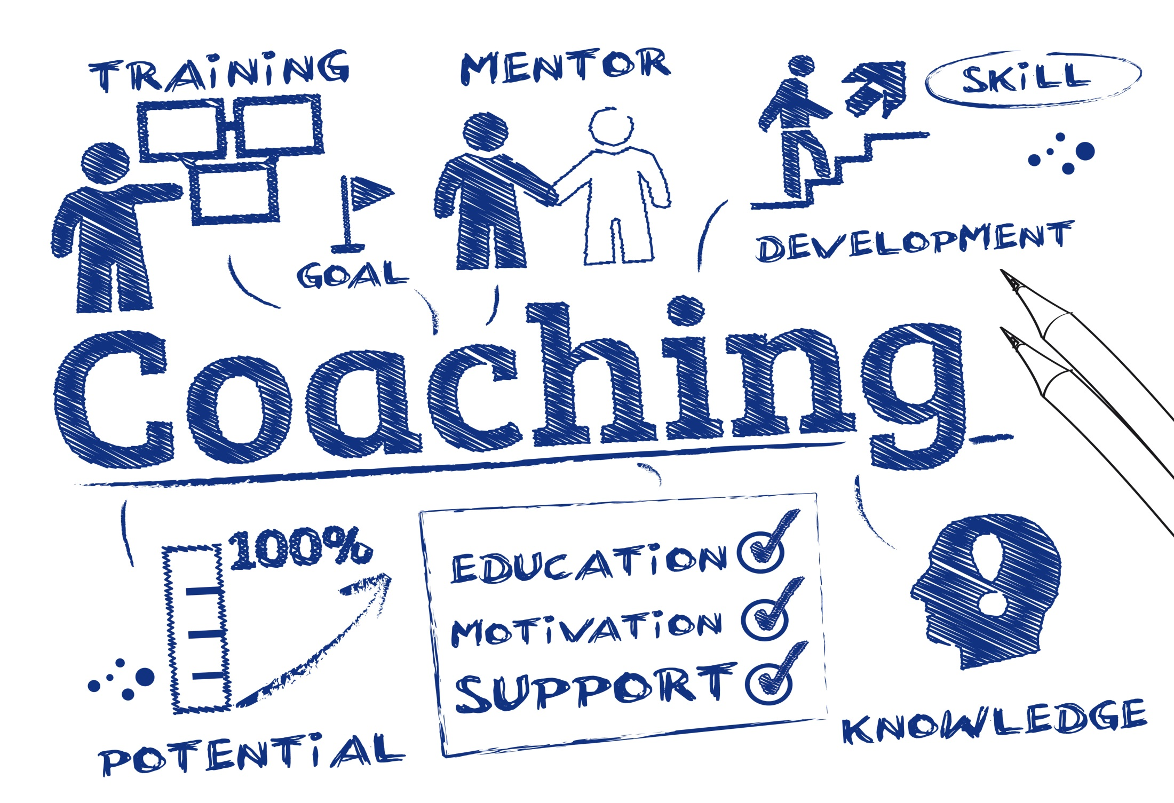
Coaching for Change
Notes:
If behavior is occurring that is disruptive to morale, productivity, harmony or teamwork, supervisors and managers need to be able to step in and address it. Recurrent incivility, rudeness or just plain insensitivity can cause unnecessary disruption and lead to even bigger concerns. We are going to run through a model for coaching that will help you to nip these problems in the bud.

Slide 75
The following Coaching tips can assist employees in being proactive in promoting respect and civility:
1. Focus on others’ needs & consider how your words & actions will impact others before you speak or act.
Approach each interaction with respect, regardless of whether you believe that the other person’s behaviors “earn” or even elicit that respect.
Notes:
Fake it till you make it
Say you’ve just been promoted to a position with job requirements that are outside of your skill set. New research shows that the best thing you can do is mimic someone else around you who displays the required skill sets, even if your first inclination is to worry about appearing like a fraud. Of her research, professor of organizational behavior Herminia Ibarra writes in the Harvard Business Review, “By viewing ourselves as works in progress, we multiply our capacity to learn, avoid being pigeonholed, and ultimately become better leaders. We’re never too experienced to fake it till we learn it

Slide 76
2. Be intentional in your communications.
Plan to listen to the other person without interruption & practice effective listening skills.
Notes:
Develop an awareness of the respect that you display in all areas of your communications, including what you say, how you say it, your voice tone, and the body language that you demonstrate.
everything comes down to how we communicate. All the things that we want and need start with a thought process that is communicated to others. Most of us do it on auto-pilot. Often that limits or derails the results we want to get. It can also leave hard feelings and unclear signals about who we are, what we want and how we really feel.
There’s a great quote by author Stephen Covey that captures the feeling content of most communication, “We judge others by their actions and ourselves by our intentions.” That’s often true but it usually happens at the back-end of communication. What’s more common is that we find ourselves in the midst of a communication and have no awareness of what our intentions are.
Distractions, lack of focus, acting from limited emotional awareness (of self and others) and emotional self-protection, the quest for clean, clear, honest communication eludes even those most dedicated to it. People seek out our services, often looking for shortcuts to easier and more “fool-proof” communication formulas. The hard truth is the developing more intentionality in how we communicate with others is a 24/7 commitment.
The driving force that shapes intentional communication is the way the people in it communicate

Slide 77
3. Become a bridge builder & act in a manner that creates an inclusive work environment.
Look for various ways to have diversity in work teams and committees as well as in individual associations
Notes:
. Be aware of the downsides caused by labeling and stereotyping others. Replace these behaviors with respect for individual differences.
How is diversity reflected in your workplace? For most, it reflects inclusiveness of cultures, orientations and more. Making a conscious effort to embrace inclusiveness and create a workplace in which people of all backgrounds feel safe and welcomed is not only good for business, but it’s also the law.
In celebration of LGBT Pride Month, here are four tips to help you create an inclusive work environment.
1. Reflect your passion for an inclusive work environment in your core/company values.
Most companies have a minimum of three-four core values. Why not dedicate one of them to inclusiveness? This will not only impress potential employees, but it will also serve as a great, engaging exercise for your current employees. Take it a step further by creating a contest for employees who want to submit new ideas for the new/revised core value. Ensure that the prize is something special.
2. Create an internal diversity & inclusion team
Before you assemble the team, be sure that you are clear on what the goal of the team is. If you need additional help, the Department of Labor (DOL) has helpful resources available. View the resources here.
3. Hire an HR professional/consultant that has experience in diversity & inclusion
If you desire to create inclusion initiatives but don’t have the time to implement, consider hiring a HR professional or consultant. Ideally, this professional will have past experience in diversity and inclusion from strategy to execution.
4. Host a diversity/inclusion workshop for your employees
Don’t have the budget to hire a full-time HR professional or consultant? Consider hiring one for a project-based initiative for your team. This can vary by topic and format, but the goal should be leave your employees with more awareness of inclusion.

Slide 78
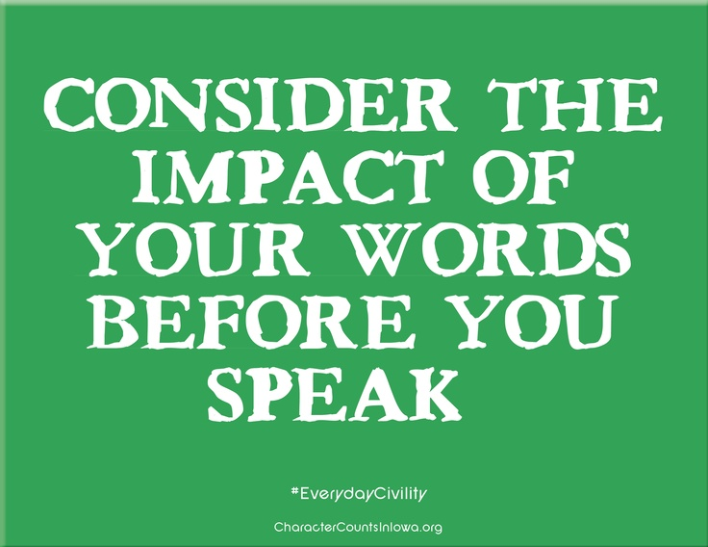
4. Appreciate the value of diverse opinions in developing approaches to varying situations.
Recognize that it does not equate to agreement if you listen, clarify what was said, and ask questions to gain an understanding of others’ opinions.
Notes:
In situations where disagreement results, learn to “agree to disagree” respectfully.

Slide 79
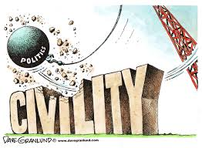
5. Understand that conflicts will occur in the workplace & take responsibility for your actions, regardless of the situation.
Take time to understand your triggers or “hot buttons.”
Notes:
Knowing what makes you angry and frustrated will enable you to manage your reactions and respond in a more appropriate manner. Practice self-restraint and focus on your overall objectives in responding to potential conflicts. A positive and solution-driven approach will facilitate your ability to reach resolution

Slide 80
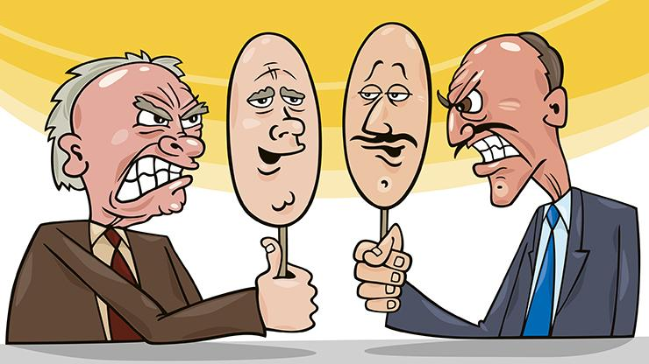
6. Guard against acting impulsively based on negative assumptions about another’s intent, as that can lead to damaged relationships.
Take time to analyze relevant facts and to reconsider your assumptions.
Notes:
Praise publically
Correct privately

Slide 81
7. Avoid tendencies to become caught up in gossip, complaining, or other forms of negativity in day-to-day interactions.
Be mindful of the following quote by Ruth Anne Crouse,
“What Peter tells me about Paul tells me more about Peter
than it tells me about Paul.”
Recognize that your actions will influence how others perceive you.

Slide 82
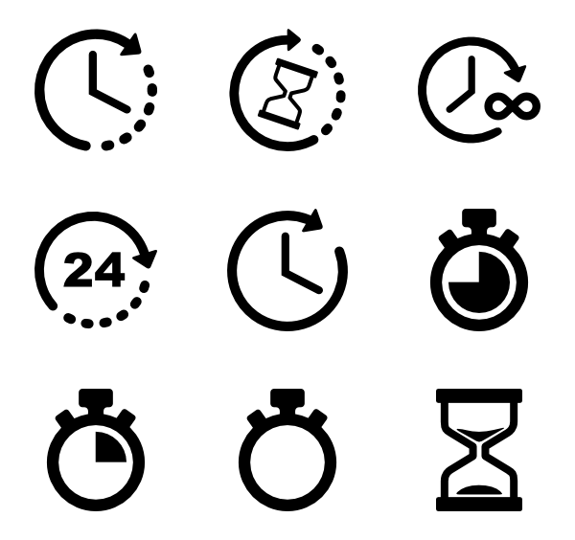
8. View today’s difficult situations from a broader & more realistic perspective by considering what they mean relative to the overall scheme of things.
Ask yourself questions such as, “How will I look back on these circumstances in a week, month, or year?”

Slide 83
9. Be supportive of your organization in your communications both inside & outside of the workplace.
Ensure that any comments that you make place the organization (including departments and individuals) in a positive yet realistic light.

Slide 84
10. Pay attention to how respectful you are in your communications and other actions on an ongoing basis.
Rate yourself (for instance, on a scale of 1-10) periodically after interactions to measure your success and to identify opportunities for improvement.

Slide 85
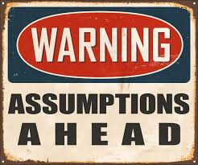
Jim Taylor,
a psychologist at the University of San Francisco, writing in the Huffington Post, contends that:
“Civility is about something far more important than how people comport themselves with others.
Rather, civility is an expression of a fundamental understanding and respect for the laws, rules, and norms (written and implicit) that guide its citizens in understanding what is acceptable and unacceptable behavior.
Notes:
For a society to function, people must be willing to accept those strictures. Though still in the distance, the loss of civility is a step toward anarchy, where anything goes; you can say or do anything, regardless of the consequences
Is Civility Dead? By Dr. Jim Taylor
Is civility dead? It sure seems so. In recent years, the quality of discourse in America has declined dramatically. Rarely in discussions of any import these days, whether politics, religion, the economy, education, the wars in Iraq and Afghanistan, the list goes on, is there a respectful exchange of ideas. Instead, such interactions are either one-sided or full of ad hominem attacks or self-serving misinformation.
Examples of those who lead the “incivility movement” are easy to come by. On the right, there’s Congressman Joe “You lie” Wilson, Congresswoman Michele Bachmann, and, of course, the Three Horsemen of the Conservative Apocalypse, Rush Limbaugh, Glenn Beck, and Bill O’Reilly.
And just so you don’t think that those on the left are holier than thou, you have Congressman Alan Grayson, the Rev. Al Sharpton, MSNBC’s Keith Olbermann and even, occasionally, Vice President Joe Biden. All are media darlings because they all make great copy. And they are quietly encouraged by the establishment. Their indiscreet comments and coronary-inducing rants go viral through new media such as YouTube and Twitter. They energize the base. And, especially for liberals, the latter provocateurs show that they are tough and aren’t going to be kicked around by those conservative bullies.
You might ask, so what? Why is civility so important? So what if they’re a little rude? It sure makes good theater (and ratings), doesn’t it?
But civility is about something far more important than how people comport themselves with others. Rather, civility is an expression of a fundamental understanding and respect for the laws, rules, and norms (written and implicit) that guide its citizens in understanding what is acceptable and unacceptable behavior. For a society to function, people must be willing to accept those strictures. Though still in the distance, the loss of civility is a step toward anarchy, where anything goes; you can say or do anything, regardless of their consequences.
What has caused such vitriol in what is now our uncivil discourse? Are passions any more intense than they were in past generations? I don’t think so. Is there more political polarization than in the past? It sure looks that way, yet research indicates that there has been little movement in political views in recent decades.
Perhaps there has always been uncivil discourse, but, because of the limits in the size of the audience that it could reach, we rarely heard it. How times have changed. Due to the emergence of cable television, talk radio, and Internet, “squeaky wheels” now have a means of making their voices heard by millions. The cable news channels and talk radio have given a soapbox to self-righteous egomaniacs who incite the lunatic fringe with impunity, have little regard for the facts, and no real concern for an actual discussion of the issues. The Internet has provided a very large megaphone to anyone who wishes to express their opinion.
Maybe uncivil discourse is the price we pay for freedom of speech. Better uncivil discourse than no discourse at all.
So is there any hope of a return to civil discourse? I’m not very optimistic. We can only hope that those who reside somewhere within the less noisy confines of the political middle continue to speak their minds - civilly, of course - and don’t let the cacophony from the fringes drown out reasoned and respectful dialogue.

Slide 86
Making this work for your organization
Important Steps!
Understand and respect individual differences:
Keep an open mind toward others who are different from you. Remember that not everyone sees things the same way you do.

Slide 87
Playing Nice with Others
All I Really Need To Know I Learned In Kindergarten
http://www.robertfulghum.com/

Slide 88
Play Nice!
Share everything.
Play fair.
Don't hit people.
Put things back where you found them.
Clean up your own mess.
Don't take things that aren't yours.
Say you're sorry when you hurt somebody.
Wash your hands before you eat.
Flush.
All I Really Need To Know I Learned In Kindergarten
http://www.robertfulghum.com/

Slide 89
Preventing Harassment through Systemic Enforcement &Targeted Outreach
Rebooting Harassment Prevention
Harassment continues to be one of the most frequently raised complaint—
over 30% of all private sector cases
43% of Federal sector cases
#solveharassment
A Bipartisan Effort
Report available at:
www.eeoc.gov/task_force/ harassment/report.cfm
Notes:
Workplace Harassment Remains a Persistent Problem. Almost fully one third of the approximately 90,000 charges received by EEOC in fiscal year 2015 included an allegation of workplace harassment. This includes, among other things, charges of unlawful harassment on the basis of sex (including sexual orientation, gender identity, and pregnancy), race, disability, age, ethnicity/national origin, color, and religion. While there is robust data and academic literature on sex-based harassment, there is very limited data regarding harassment on other protected bases. More research is needed.
Workplace Harassment Too Often Goes Unreported. Common workplace-based responses by those who experience sex-based harassment are to avoid the harasser, deny or downplay the gravity of the situation, or attempt to ignore, forget, or endure the behavior. The least common response to harassment is to take some formal action – either to report the harassment internally or file a formal legal complaint. Roughly three out of four individuals who experienced harassment never even talked to a supervisor, manager, or union representative about the harassing conduct. Employees who experience harassment fail to report the harassing behavior or to file a complaint because they fear disbelief of their claim, inaction on their claim, blame, or social or professional retaliation.
There Is a Compelling Business Case for Stopping and Preventing Harassment. When employers consider the costs of workplace harassment, they often focus on legal costs, and with good reason. Last year, EEOC alone recovered $164.5 million for workers alleging harassment –and these direct costs are just the tip of the iceberg. Workplace harassment first and foremostcomes at a steep cost to those who suffer it, as they experience mental, physical, and economic harm. Beyond that, workplace harassment affects all workers, and its true cost includes decreased productivity, increased turnover, and reputational harm. All of this is a drag on performance – and the bottom-line.
It Starts at the Top – Leadership and Accountability Are Critical. Workplace culture has the greatest impact on allowing harassment to flourish, or conversely, in preventing harassment. The importance of leadership cannot be overstated – effective harassment prevention efforts, and workplace culture in which harassment is not tolerated, must start with and involve the highest level of management of the company. But a commitment (even from the top) to a diverse, inclusive, and respectful workplace is not enough. Rather, at all levels, across all positions, an organization must have systems in place that hold employees accountable for this expectation. Accountability systems must ensure that those who engage in harassment are held responsible in a meaningful, appropriate, and proportional manner, and that those whose job it is to prevent or respond to harassment should be rewarded for doing that job well (or penalized for failing to do so). Finally, leadership means ensuring that anti-harassment efforts are given the necessary time and resources to be effective.
Training Must Change. Much of the training done over the last 30 years has not worked as a prevention tool – it’s been too focused on simply avoiding legal liability. We believe effective training can reduce workplace harassment, and recognize that ineffective training can be unhelpful or even counterproductive. However, even effective training cannot occur in a vacuum – it must be part of a holistic culture of non-harassment that starts at the top. Similarly, one size does not fit all: Training is most effective when tailored to the specific workforce and workplace, and to different cohorts of employees. Finally, when trained correctly, middle-managers and first-line supervisors in particular can be an employer’s most valuable resource in preventing and stopping harassment.

Slide 90
Workplace harassment remains a persistent problem.
There is a compelling business case for preventing harassment.
Workplace harassment too often goes unreported.
Findings
Leadership and accountability can prevent harassment.
The good news:
We have some creative ideas.
Workplace risk
factors should be evaluated.
Employers should consider Workplace Civility Training and Bystander Intervention Training.
An It’s On Us campaign in the workplace
could be a
game changer.
Training is
important, but it
needs to be
the right
training.
Employers need compliance training that is effective.

Slide 91
Check out the Checklists!
1. Leadership & Accountability p. 79
2. Anti-Harassment Policy p. 80
3. Reporting Procedures & Investigations p. 81
4. Compliance Training p. 82
Appendix B: Checklists for Employers
https://www.eeoc.gov/eeoc/task_force/harassment/upload/report.pdf

Slide 92
How does your workplace compare?
Check out Appendix C: Risk Factors & Responses for strategies to reduce harassment
Cultural and language differences
in the workplace
Workplaces with significant power disparities
Workplace cultures that tolerate or encourage alcohol consumption
Homogeneous workforces
Workplaces where some workers do not conform to workplace norms
Workplaces where work is monotonous or consists of low-intensity tasks
Workforces with
many young workers
Isolated workspaces
Workplaces that rely on customer service or client satisfaction
Workplaces with
‘high value’ employees
Coarsened social
discourse outside
the workplace
Decentralized workplaces
https://www.eeoc.gov/eeoc/task_force/harassment/upload/report.pdf

Slide 93
Prevalence of Sex-Based Harassment
Varying Definitions
60%
40%
25%
More Accurate Estimate
40% of women experience unwanted sexual attention or sexual coercion, even if they don’t label it as “sexual harassment.”
Most Accurate Estimate
60% of women experience unwanted sexual attention or sexual coercion, OR sexually crude conduct or sexist comments in the workplace.
Most Conservative Estimate
25% of women experience “sexual harassment,” if not defined in the survey.

Slide 94
Harassment is HUGELY UNDER-REPORTED
85%
70%
Upwards of 85% of people never file a formal legal charge.
Approximately 70% of employees never even complain internally.

Slide 95
Instead……
Common Responses to Harassment
Avoid the harasser
Endure the behavior
Downplay the gravity of the situation
Seek support from family & friends
Attempt to forget the harassment
Leave the job, if one can

Slide 96
IT’S ON US- IN THE WORKPLACE
Employees should feel a sense of
collective responsibility &
empowerment
to stop harassment at work.
EEOC wants to act as a catalyst
to help launch an
“It’s on Us” campaign
in the workplace.

Slide 97
Resources
Webershandwick.com. Civility in America 2011. Weber Shandwick. Powell Tate. KRC Research.
Harvard Business Review. The Price of Incivility. Christine Porath and Christine Pearson. Jan. 26, 2013.
HR Times Magazine. 7 Steps to a Bully-Free Workplace: Deliver a culture of civility to your organization & sustain the positive change. Catherine Michael Mattice, M.A. 4th Quarter, Vol 3, Issue 4.
www.NoWorkplaceBullies.com
Human Resource Development Quarterly. Managing Workplace Incivility: The role of Conflict Management Styles - Antecedent or Antidote? Jeannie Trudel, Thomas G. Reio Jr. Vol. 22, no. 4, Winter 2011. Wiley Periodicals.
Academy of Management Review. Unseen Justice: Incivility as modern discrimination in organizations. Cortina L.M. 2008. 71.
Hreonline.com. How Rude. Jared Shelly, July 29, 2013.
WashingtonPost.com. Joyce E.A. Russell. Cultivating civility in the workplace. June 17, 2012.
SHRM.org. Managing Difficult Employees and Disruptive Behaviors. Toolkits. 4/10/12.
SHRM HR Magazine. Incivility Rising. Donna M. Owens. Vol. 57 No.2. 2/1/12.
www.Civilitypartners.com
Journal of Business and Psychology. The impact of organizational culture on attraction and recruitment of job applicants. Catanzaro, D., Moore, H., & Marshall, T.R. (2010). 25 (4), 649-662.
The Tipping Point. Malcolm Gladwell, Jan. 7, 2002. Back Bay Books.
The Great Workplace: How to Build It, How to Keep It, and Why It Matters. Michael Burchell and Jennifer Robin. Jan. 4, 2011. Jossey-Bass.
The Manager’s Book of Decencies. Steve Harrison. 2007. Adecco Management and Consulting.
www.tncwr.org

Slide 98
Contact Information & Resources
U.S. Equal Employment Opportunity Commission
Joe Bontke M.Ed.
Education & Outreach Coordinator
713 907 2855 cell
713 651 4994 Desk
joe.bontke@eeoc.gov
@EEOC_Houston
Toll-free: 1-800-669-4000
TTY: 1-800-669-6820
www.eeoc.gov
eeoc.traininginstitute@eeoc.gov

